Slide 1
Surviving Shift Work

Slide 2
DISCLAIMER
This presentation is supported by the Grant or Cooperative Agreement Number, U60OH010017, funded by the Centers for Disease Control and Prevention. Its contents are solely the responsibility of the authors and do not necessarily represent the official views of the Centers for Disease Control and Prevention or the Department of Health and Human Services.

Slide 3
Facts about Shift Work
15% of the US workforce works outside the traditional workday of 7am to 6pm
10% of night and rotating shift workers have shift work disorder
25-30% experience symptoms of excessive sleepiness or insomnia
Notes:
15% of US workforce works outside the traditional workday ~ 25 million
10% of night and rotating shift workers are thought to have shift work disorder ~ 2.5 million
25-30% of shift workers experience symptoms of excessive sleepiness or insomnia ~6.25 – 7.5 million
673,000 people employed in mining
An estimated 15% of the U.S. workforce works outside the traditional 9 am – 5 pm workday—this can mean early morning shifts, night shifts, or rotating shifts.
There is variability in how shift work affects people. For example, studies have shown that some, but not all, rotating shift workers experience sleep disturbances.
Approximately 10% of night and rotating shift workers are thought to have shift work disorder. Between roughly 25-30% of shift workers experience symptoms of excessive sleepiness or insomnia.
Even if you get enough hours of sleep, you may still experience some symptoms of shift work disorder. This is because your internal clock continues to send you drowsy-making signals during the night (as it is naturally programmed to do), even if you’ve technically slept enough during the day.
Many shift workers have jobs that naturally require them to be on high alert and make quick, important decisions (such as people in the transportation, medical, and public safety fields). This is what makes shift work sleep disorder especially dangerous.
Night work or rotating shifts may contribute to health conditions like heart disease and cancer.

Slide 4
IARC
GROUP 1
Sufficient evidence in humans.
Causal relationship established.
CARCINOGENIC TO HUMANS
2007
Shift work involving circadian disruption
GROUP 2A
PROBABLY CARCINOGENIC
TO HUMANS
Limited evidence in humans.
Sufficient evidence in animals.
2019
Night shift work
GROUP 2B
POSSIBLY CARCINOGENIC
TO HUMANS
Limited evidence in humans.
Insufficient evidence in animals.
GROUP 3
CARCINOGENICITY
NOT CLASSIFIABLE
Inadequate evidence in humans.
Inadequate evidence in animals.
GROUP 4
PROBABLY NOT
CARCINOGENIC
Evidence suggests no carcinogenicity in humans/animals.
Notes:
In 2007 the International Agency for Research on Cancer (IARC) classified night work as a “probable human carcinogen,” since then researchers have been searching for the biological mechanisms involved. The investigators believe that a prime suspect is the disruption of human circadian rhythms (24 hour ‘body clock’). Circadian rhythms occur in hormone levels, hunger, sleep, body temperature as well as in a variety of other physiological aspects of health. The investigation appears in the October issue of Chronobiology International.
In 2007, the IARC decided to classify night shift work as a potential carcinogen due to its disruption of the body’s circadian rhythm. This fact places great importance on circadian rhythms.
In June 2019, a working group convened by the International Agency for Research on Cancer (IARC) concluded that “night shift work” is “probably carcinogenic to humans” (Group 2A).
The working group importantly qualified what was evaluated as comparatively different to IARC’s 2007 verdict. That is to say, IARC classified “shiftwork involving circadian disruption” as probably carcinogenic to humans in 2007 [3] and this year the working group zoned in on “night shift work” [2].

Slide 5
IARC
GROUP 1
GROUP 2A
Cause Cancer
Cancer Risk
GROUP 2B
GROUP 3
GROUP 4
Notes:
The IARC’s index only tells us how strong the evidence is that something causes cancer.
Substances in the same category can differ vastly in how much they increase cancer risk.It does not tell you how much they increase cancer risk within group.
Two analyses of data from different studies found that night work increased the risk of breast cancer by 50%. Working shifts on airplanes, like pilots and flight attendants do, increased the risk by 70%. There's evidence that shift work might increase the risk of colorectal and prostate cancer as well.

Slide 6
Master Clock it Controls Everything
Notes:
So far we have discussed the why we need sleep and what happens if we don’t get enough sleep. Now we are going to give you some helpful tips for a sleeping better.

Slide 7
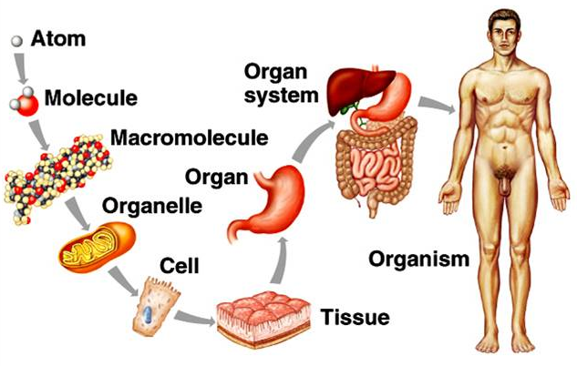
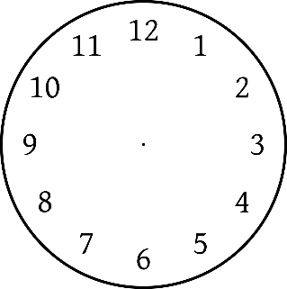
Master Clock
Atom
Atom
Organ System
Molecule
Macromolecule
Organ
Organelle
Cell
Organism
Tissue
Notes:
Every body has a master clock to regulate when it sleeps and wakes, works and rests. In the body, every cell and organ each has its own clock, to tell it to be active and rest at a certain time of the day. All of the clocks are synchronized together and regulated by the circadian rhythm or circadian timekeeping system. The circadian rhythm is entrained by environmental light cycles.
Living organisms on the earth synchronize their activity to a 24-hour light and dark cycle generated by the rotation of the earth. This biological rhythm is called the circadian rhythm, which means “approximately one day.” Each cell within unicellular organisms, cultured cell lines, and cells composing tissues has its own circadian clock.
In animals, the circadian rhythm of cells in tissues is synchronized by the suprachiasmatic nucleus (SCN) located in the hypothalamus via nerves or humoral signals. The SCN clock is called the central clock and that within each tissue is called the peripheral clock.

Slide 8
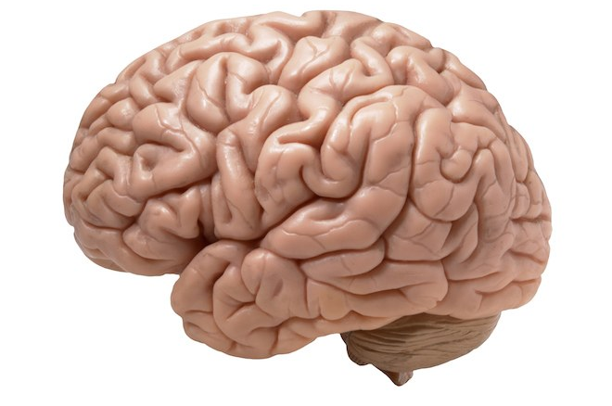
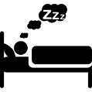
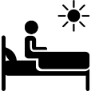
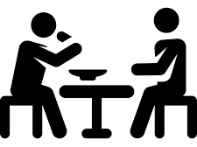
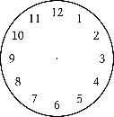
Circadian Rhythm
Hormonal Rhythms
Core Body Temperature Rhythm
Sympathetic/ Parasympathetic Systems
Circadian Clocks in Peripheral Organs
Notes:
These clocks are synchronized together and regulated by the circadian timekeeping system which is entrained by environmental light cycles.
Sleep/wakefulness → Rest activity rhythm → Feeding pattern
Day/Night
Social
Familial
Meal timing
Circadian clock in peripheral organs
Cell cycle apoptosis
DNA repair
Drug metabolism
Detoxification
Angiogenesis
Suprachiasmatic Nucleus of the hypothalamus above the optic chiasma
Hormonal Rhythms – Melatonin
The parasympathetic nervous system (PNS) controls homeostasis and the body at rest and is responsible for the body's "rest and digest" function. The sympathetic nervous system (SNS) controls the body's responses to a perceived threat and is responsible for the "fight or flight" response.
Angiogenesis – development of new blood vessels
Apoptosis – death of cells as part of an organisms growth or development

Slide 9
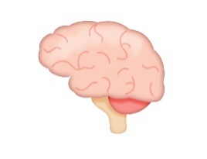
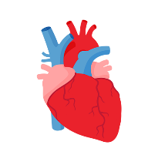
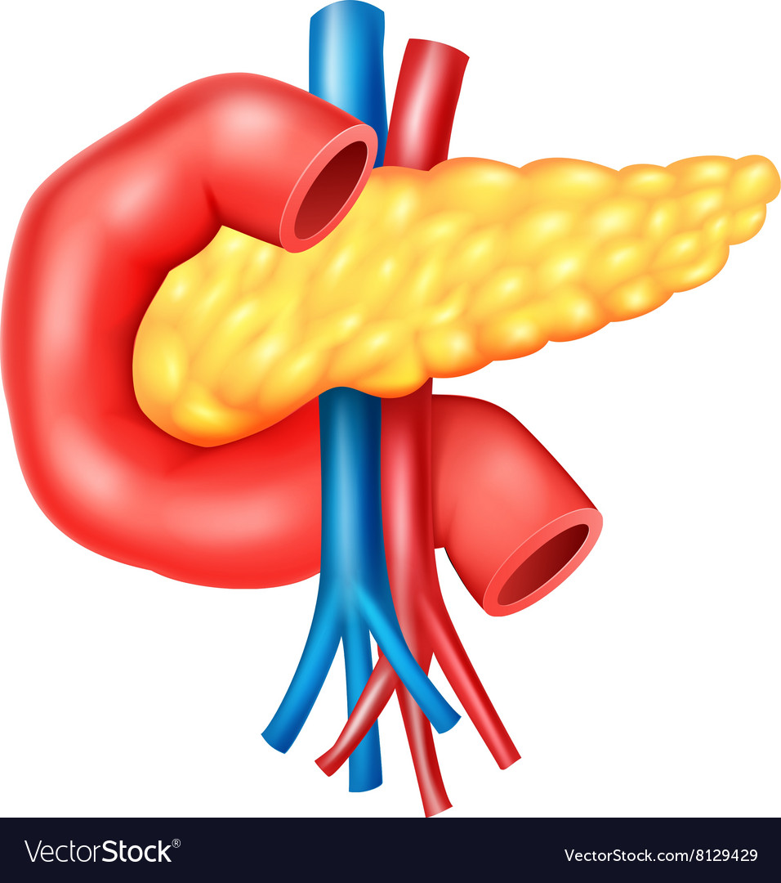
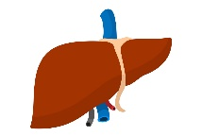
Circadian Disruption
Genetic
Mental Health Disorders
Aging
Clock gene mutation
Cardiovascular Diseases
Environmental
Shift work
Jetlag
Sleep restriction
Diabetes
Inflammation
Obesity

Slide 10
Schedule Your Work does the time matter?
Notes:
So far we have discussed the why we need sleep and what happens if we don’t get enough sleep. Now we are going to give you some helpful tips for a sleeping better.

Slide 11
Larks and Owls
Notes:
Sleep needs change from one person to the next. Some people wake up easily in the morning, called Larks. Others are more energetic at the end of the day, called Owls. These are known as chronotypes, which is simply put, your body’s internal clock.
These chronotypes are largely influenced by genetic factors. That being said, our biological clock is more complex and flexible than that. External factors known as synchronizers or time-setters can influence chronotypes over time. For example, years and years of working an early morning job can transform habits and turn you into a morning person.

Slide 12
Clockwise Rotating Shifts
Day
Evening
Morning
Night
Notes:
Night shifts
Try to keep the same sleep and wake times each day, even on your days off. This will help regulate your circadian rhythm, improve your sleep quality, and also help you be alert during your shift
Preferred way to adapt to rotating shifts -- The change process should take two weeks. Ideally, the person should shift forward by delaying the sleep time by 2 hours every third day, for total of three times This approach is the easiest way for your internal clock to adjust to the rotating shift.
Shift systems that rotate employee schedules from morning shifts to evening shifts to night shifts have a forward rotation, whereas shifts that rotate counterclockwise (i.e., night to evening to morning) have a backward rotation. With regard to the speed of rotation, shift systems fall into three major categories: (a) permanent shift systems (e.g., permanent night shift); (b) slowly rotating shift systems (e.g., weekly rotating); and (c) rapidly rotating shift systems (e.g., an employee works the morning shift on Monday, the evening shift on Tuesday and Wednesday, and the night shift on Thursday and Friday).

Slide 13
Things to Remember
Avoid safety-critical tasks towards the end of your shift
Commuting while tired is dangerous
Adaptation to working night shifts is rare
Notes:
Absolutely. Based on the study we understand the impact of the night shift on alertness, particularly toward the end of a shift where additional strategies may be needed to protect staff from reduced alertness, such as avoidance of safety-critical tasks, double-check procedures or personalised tools to enhance alertness.
This also extends to safety on the commute home from night shifts where staff may be at risk relative to day shifts.
Further, we show that measurement or prediction of the timing of an individual workers body clock can help to better understand where their alertness is likely to be more impaired during a shift and strategies to reduce safety risks can be implemented.
Another key finding is that biological adaptation to working night shifts is rare so working multiple consecutive night shifts does not mean alertness of workers will improve at the end of a run of nights as some people believe. In the discussion section of the paper, we elaborate more on the wider implications.

Slide 14
Surviving Shift Work
Sleep
Eat
Socialize
When and how do I do Life ?

Slide 15
Sleep why is it so hard?

Slide 16
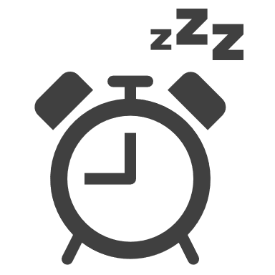
People who work nights tend to sleep 4 hours less per week than day workers.
How much sleep
is enough?
7-9 hours each night
Notes:
How much sleep is enough?
Experts agree that adults need 7-9 hours of sleep each night. The exact amount is a function of genetics. Don’t be fooled into thinking that you are one of those people who is just fine on less than 6 hours of sleep as less than 1% of the population can survive on 6 hours or less without impairment.
A great example of this is the story of Michel Siffre, who as a 23-year old geologist in 1962, conducted the first long-term isolation experiment inside an underground glacier in the Alps. Plunged into darkness for 58 days, he was deprived of any external factors. However, he continued to sleep for eight hours every 24 hours or so, suggesting that sleep is a genetic cycle!

Slide 17
The Vicious Cycle
Sleep Deprivation
Work Schedule
Family/Social Life
Stressors
Fatigue
Work
Family/Social
Financial
Diminishes ability to cope with stressors in a healthy way
Notes:
Disrupted sleep increases fatigue
Fatigue diminishes ability to cope with stressors in a healthy way
Inability to cope with stressors disrupts sleep

Slide 18
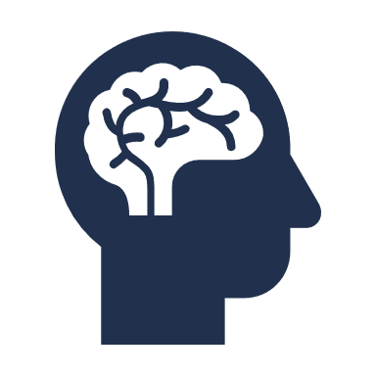
Dangers of Sleep Deprivation
Mental health disorders
Cognitive function
Lack of sleep =
Immune response
Heart problems
Obesity & diabetes
Rates of cancer
Accidents & Injuries
Addiction

Slide 19
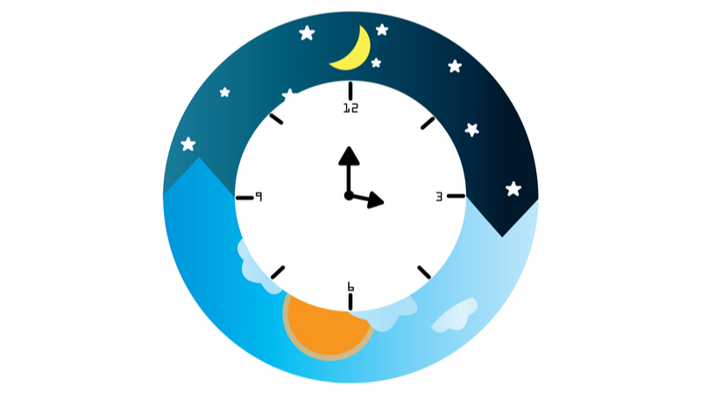
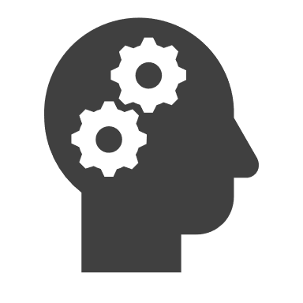
What Controls Sleep?
Sleep Pressure
Sleep
Awake
Circadian Rhythm
Notes:
Understanding basic principles of sleep regulation is helpful for determining strategies to adapt to shift work and long work hours.
Humans are "hard-wired" for sleeping during the night and being active during the day. Researchers explain that sleep regulation has two components
Build-up of homeostatic sleep drive
Circadian rhythms
These two components interact to determine the time when we go to sleep and the time when we wake up, as well as the stability of waking neurocognitive functions (e.g., how well we feel when we are awake).

Slide 20
Sleep Pressure
Energy
ATP
Adenosine
Adenosine Triphosphate
Notes:
Let’s look at sleep pressure. Sleep pressure is a result of energy use which causes a buildup of a substance called adenosine.
How is Adenosine created? A substance called Adenosine Triphosphate (ATP) is the universal energy source for all of our cells. To give energy to our cells, ATP undergoes a type of decaying process which transforms it to Adenosine.
As the day goes on, the more your body uses energy, the more the ATP “decays” and the more Adenosine is created. This causes a buildup throughout the day causing you to feel sleepy.

Slide 21
Adenosine
Sleep Neuron
Adenosine
Adenosine Activates
Adenosine Puts to Sleep
Awake Neuron
Notes:
How does Adenosine make you feel sleepy?
SA1 -- Adenosine likes to fix itself onto the neurons (or brain cells) that are responsible for you waking up and deactivates them.
SA2 -- And it works the other way around too, it fixes onto the “sleep” neurons and activates them.
In other words, during the day, the gathering of adenosine in the brain will fiercely “put to sleep” the neurons that keep us awake and inversely, stimulate those who make us fall asleep!
From a certain level, the drowsy effect is hard to fight.

Slide 22
Sleep Regulation
FALL
ASLEEP
WAKEFULNESS
WAKE UP
Circadian Rhythm
SLEEP PRESSURE
Sleep Pressure
AWAKE
SLEEP
AWAKE
16 hours
8 hours
16 hours
Notes:
Sleep Pressure (Homeostatic Sleep Drive)
Pressure for sleep (homeostatic sleep drive) builds up in our body as our time awake increases. The pressure gets stronger the longer we stay awake and decreases during sleep, reaching a low after a full night of good-quality sleep. The homeostatic process begins to build again after we awaken. The dashed line represents potential increases in pressure to sleep, which will continue to build if sleep does not occur.
Our body produces a higher drive for sleep under some circumstances. When the immune system is fighting an infection, it produces more immune mediators, which cause more sleepiness. Also, cognitively stimulating or demanding experiences (such as sightseeing) and physically demanding experiences could increase sleep pressure further. As a result, our sleep may be longer and deeper after those experiences.
Circadian Rhythms
Circadian rhythms promote sleepiness before usual bedtime, help initiate sleep, and begin promoting wakefulness before usual wake-up time in the morning.
Circadian rhythms are internally driven cycles of biochemical, physiological, and behavioral processes of living beings that rise and fall across the 24-hour day. There are numerous peripheral circadian oscillators (clocks) throughout the human body that drive circadian rhythms. A master circadian pacemaker (sometimes called the circadian clock) in the hypothalamus of the brain (see Figure 2.4) synchronizes and controls the timing of these peripheral circadian oscillators so they work together.
Circadian rhythms promote sleepiness before usual bedtime, help initiate sleep, and begin promoting wakefulness before usual wake-up time in the morning. The pacemaker has an internally driven 24-hour rhythm that tends to run longer than 24 hours but is reset every day by external timing cues to keep the cycle at 24 hours. The light/dark cycle of the sun is the strongest cue.²⁵ Exercise and melatonin also appear to influence the timing of the pacemaker, but not as much as light. Normally, light enters the eye (even through closed eyelids during sleep) and signals to the pacemaker the time for awakening and activity and the time for sleep (see Figure 2.4).
As well as sleep and wakefulness, the pacemaker sets the timing for numerous circadian rhythms that regulate physiological and behavioral processes, such as those related to the following:
-Hormones
-Body temperature rhythm
-Eating and digesting food

Slide 23
Misaligned Sleep Regulation
FALL
ASLEEP
WAKE
UP TOO EARLY
SLEEP PRESSURE
Sleep Pressure
WAKEFULNESS
Circadian Rhythm
SLEEP
WORK
WORK
8:00 AM
1:00 PM
11:00 PM
7:00 AM
7:00 AM
Notes:
If a night shift worker's circadian system has not adjusted to working at night and sleeping during the day, the sleep pressure drive and circadian rhythms for wakefulness will not be synchronized and, as a result, will not work together. As shown in Figure 2.6b, the circadian rhythms that drive wakefulness will continue to rise during the daytime, pushing the person to be awake, and will fall at night, pushing the person to go to sleep. The sleep pressure drive will increase while the worker is awake. As a result, night workers tend to fall asleep quickly in the morning after their work shift, because they have high pressure for sleep from being awake a long time (as shown on the graph). But their sleep can be disturbed and they can have difficulty remaining asleep long enough because circadian rhythms that drive wakefulness are increasing and pushing them to wake up. Noise or minor discomfort can awaken them more easily because of the rising drive for wakefulness. On awakening, they may not feel refreshed, but can have difficulty going back to sleep. Because of insufficient sleep, the sleep pressure drive will not decrease fully (dashed line in Figure 2.6b indicates usual fall in sleep pressure drive after a good night's sleep). This may lead to sleepiness and fatigue when awake. When working at night, a worker's circadian rhythms for wakefulness decrease, causing strong feelings of sleepiness, especially between 2 a.m. and 6 a.m. At the end of the shift, night nurses are at maximum risk for sleepiness from both high sleep pressure and low circadian drive for wakefulness. This is the time for maximum risk of vehicle crashes due to drowsy driving which endangers the nurse as well as other people on the roads.

Slide 24
Eat What & when

Slide 25
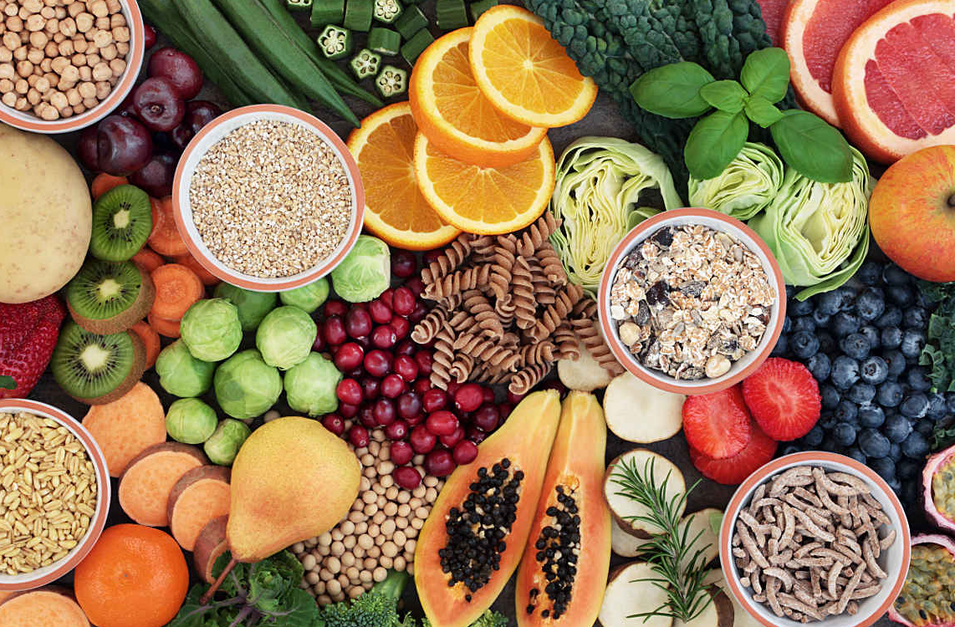
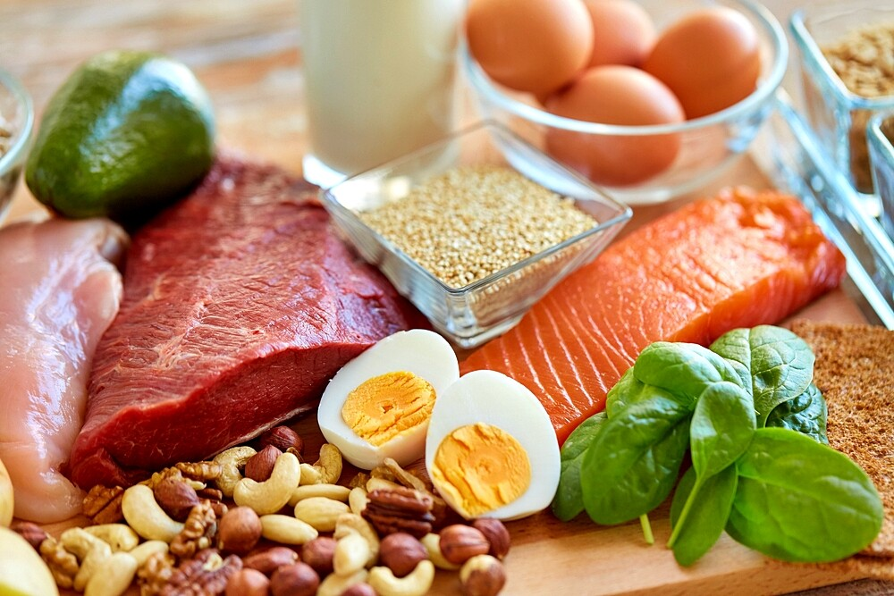
Eat Good. Feel Good.
Eat real food
Find a new routine
Protein before work
Carbohydrates at last meal/snack
Pick the right snacks
Enjoy your meals
Stay hydrated
Notes:
Remember!
5-6 hours between meals
4 hours between last meal and bedtime

Slide 26
Socialize How to Live your best life

Slide 27
Remember…
People are important!

Slide 28
Surviving Shift Work
Sleep
Eat
Socialize
When and how do I do Life ?

Slide 29
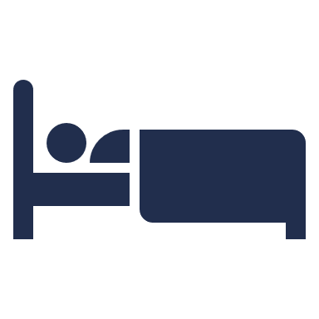
Shift Work Strategies schedule your life
Sleep
Eat
Socialize

Slide 30
Strategy #1 sleep all at once
1
5-6 hours between meals
2
Guidelines
4 hours between last meal and bedtime
3
8 hours of sleep

Slide 31
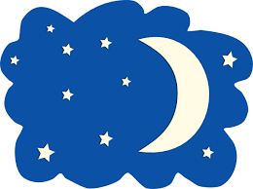
Strategy #1 sleep all at once
Guidelines
Wake/ Breakfast
Bed
Time
Wake/ Breakfast
5-6 hours between meals
4 hours between last meal and bedtime
8 hours of sleep
Lunch
Dinner
1
Day Shift
5-6 hrs
5-6 hrs
4 hrs
8 hrs
6 8 10 12 2 4 6 8 10 12 2 4 6 8
2
6 8 10 12 2 4 6 8 10 12 2 4 6 8
Night Shift
8 hrs
5-6 hrs
5-6 hrs
4 hrs
3
Bed
Time
Wake/ Meal
Meal
Meal
Bed
Time
Family/ Social Time

Slide 32
Strategy #2 anchor your sleep
1
5-6 hours between meals
2
Guidelines
4 hours between last meal and bedtime
3
8 hours of sleep with modification

Slide 33
Strategy #2 anchor your sleep
 | Sunday | Monday | Tuesday | Wednesday | Thursday | Friday | Saturday
12:00 AM | Meal | Meal
1:00 AM
2:00 AM
3:00 AM
4:00 AM |  |  | Meal | Meal | Meal | Meal | Meal
5:00 AM
6:00 AM
7:00 AM
8:00 AM
9:00 AM
10:00 AM
11:00 AM
12:00 PM | Meal | Meal
1:00 PM
2:00 PM
3:00 PM
4:00 PM |  |  | Meal | Meal | Meal | Meal | Meal
5:00 PM
6:00 PM | Meal | Meal
7:00 PM
8:00 PM
9:00 PM
10:00 PM |  |  | Meal | Meal | Meal | Meal | Meal
11:00 PM
Sleep Anchoring
Light Brake
Notes:
Light Brake – entails curtaining the sleep period on the last night of consecutive shifts to increase sleep drive on the subsequent sleep period

Slide 34
Strategy #3 Break it up
1
5-6 hours between meals
2
Guidelines
4 hours between last meal and bedtime
3
8 hours of sleep in two 3-5 hour blocks

Slide 35
Strategy #3 break it up
Guidelines
Wake/ Breakfast
Bed
Time
Wake/ Breakfast
5-6 hours between meals
4 hours between last meal and bedtime
8 hours of sleep in two 3-5 hour blocks
1
Lunch
Dinner
Day Shift
5-6 hrs
5-6 hrs
4 hrs
8 hrs
2
6 8 10 12 2 4 6 8 10 12 2 4 6 8
6 8 10 12 2 4 6 8 10 12 2 4 6 8
Night Shift
3-5 hrs
5-6 hrs
3 hrs
5-6 hrs
4 hrs
3
Bed
Time
Wake/ Meal
Meal/ Bed Time
Wake/ Snack
Meal
Bed
Time
Family/ Social Time
Notes:
4. Anchor Sleep
Despite conflicting hours, shift workers want a social life too. This often means changing their sleep schedule on their days off to accommodate a social life. This throws off circadian rhythms, leading to sleep deprivation and sleepiness. ‘Anchor sleep’ encourages the overlapping of at last 4 hours of sleep during the same time frame on your work days and your off days.

Slide 36
Strategy #4 Take a nap
1
5-6 hours between meals
2
Guidelines
4 hours between last meal and bedtime
3
8 hours of sleep in a 6-7 hour block plus a 1-2 hour nap

Slide 37
Strategy #4 take a nap
Light
Sleep
90
MIN
Wake Up
Refreshed
75
MIN
15
MIN
20 MIN
60
MIN
30
MIN
Wake Up Groggy
Deep
Sleep
45
MIN

Slide 38
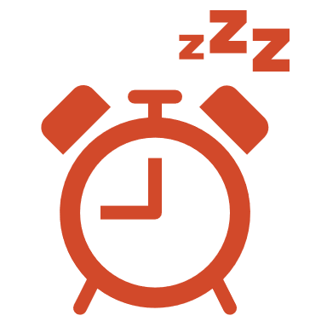
Strategy #4 Take a nap
Be Strategic
2-5 am
Strongest
Sleep Drive
12-2 am
2-4 pm
Best Nap
Times
11a-12p
1-3 hours before bedtime
Worst Nap
Times

Slide 39
Strategy #4 Take a nap
Guidelines
Wake/ Breakfast
Bed
Time
Wake/ Breakfast
5-6 hours between meals
4 hours between last meal and bedtime
8 hours of sleep in a 6-7 hour block plus a 1-2 hour nap
1
Lunch
Dinner
Day Shift
5-6 hrs
5-6 hrs
4 hrs
8 hrs
2
6 8 10 12 2 4 6 8 10 12 2 4 6 8
6 8 10 12 2 4 6 8 10 12 2 4 6 8
Night Shift
6-7 hrs
5-6 hrs
4-5 hrs
4 hrs
3
1-2 hrs
Meal/ Nap
Bed
Time
Bed
Time
Wake/ Meal
Wake
Meal
Family/ Social Time

Slide 40
Helpful Tips start out on the right foot

Slide 41
Uppers and Downers
Notes:
Avoid caffeine and alcohol 5-6 hours before bedtime
Caffeine 5 hour half life
Pint of beer 2 hour metabolism
Stimulants
Caffeine
Nicotine
Depressants/Sedative
Alcohol
Cigarettes (sedative properties)
Sleep aids
Sleeping pills
Melatonin (signals to initiate sleep)
Sleep Aids
Sedative hypnotic
Does not induce natural sleep
Reduced quality
Unwanted side effects

Slide 42
Nicotine
What is Nicotine?
A stimulate in small doses
A sedative in large doses
What does it do?
Decreases sleep quality
Increases sleep disturbances
Can cause sleep apnea, snoring, and insomnia
Rule of thumb:
Quit while you’re ahead
Notes:
Some people will tell you that nicotine gives them a burst of energy and some people will say it makes them sleepy. This is true on both accounts, but is likely because of the dose. Nicotine is actually both a sedative and a stimulant, but it depends on how much is consumed.
Nicotine as a Stimulant
Nicotine works as a stimulant in the body almost immediately because it stimulates the adrenal glands. This stimulation releases adrenaline, which causes a release of glucose.
The increase of glucose translates to increased blood sugar levels This gives you instant energy, just like when we eat processed foods like white bread. When this process happens with food, the body releases insulin to tell our cells to absorb this sugar and bring blood glucose down to safe levels. This is the crash that you get after eating crappy food that turns into sugar in the body. Your energy goes up but then your body forces it to come back down.
But nicotine works differently than food. Nicotine actually suppresses insulin output, which means the blood sugar remains in the blood, rather than being absorbed by the cells. This causes users to be slightly hyperglycemic, which means there is an excessive amount of glucose in the bloodstream. This is why doctors recommend against people with diabetes using nicotine.
All of this means that nicotine will give you a similar energy rush as processed foods, but the energy will last a lot longer.
Another way that nicotine can increase energy is because it causes a release of dopamine in the brain. Dopamine is a neurotransmitter that encourages us to act and be motivated.
Nicotine as a Sedative
Nicotine can also be a sedative. Once nicotine reaches the brain, it causes the release of many different hormones and neurotransmitters, one of which being beta-endorphin.
Beta-endorphin reduces anxiety and is used in the body to numb pain. It’s the endorphin your body releases after some sort of physical trauma. It activates opioid receptors and has 18 to 33x the potency of morphine. This is your body’s natural painkiller. If you’re a runner, you’d recognize this is a runner’s high during a long endurance run.
Beta-endorphin can also ease emotional distress, create a sense of well-being, and produce a sense of euphoria.
Using Nicotine To Get Your Desired Results
Are you looking for energy or a way to relax?
Studies have shown that nicotine starts out as a stimulant in small dosages, but when the dose increases, it changes into a sedative.
So if you want energy, take a few quick puffs and move on. If you want to relax, take long drags and chain vape for a longer period of time.
There doesn’t appear to be an exact dose at which either effect changes. It likely depends on the person and their sensitivity to nicotine.

Slide 43
Alcohol
What is alcohol?
A sedative
What does it do?
Increases sleep onset
Decreases sleep quality
Increases sleep disturbances
Can cause sleep apnea and insomnia
Rule of thumb:
Limit intake to one drink
1-4 hours before bedtime
Notes:
When alcohol is consumed, alcohol blocks the reuptake of adenosine, which leads to an elevation in adenosine activity.
Type of Alcoholic Beverage and Average Time to Metabolize
Small Shot of Liquor -- 1 hour
Pint of Beer -- 2 hours
Large Glass of Wine --3 hours
A Few Drinks -- Several hours

Slide 44
Caffeine
What is caffeine?
A stimulant
What does it do?
Decreases sleep quality
Increases sleep disturbances
Delays sleep on set
Rule of thumb:
300 mg caffeine per day
Stop drinking by 1pm
Notes:
While alcohol blocks the reuptake of adenosine, caffeine is an adenosine antagonist drug. Caffeine is most effective when adenosine activity is high and the individual is feeling very sedated or sleepy.
Now that we know how caffeine disrupts sleep, it is suggested that you have a caffeine curfew of 1 pm. With a half-life of 5-6 hours, let’s take a look at an example of how much caffeine could be left in your body assuming you have consumed 300 mg by 10am. Remember, this is only three 8oz cups of coffee or one venti cold brew at Starbucks. At 10am you have 300 mg in your system, by 3pm it is reduced to 150 mg and by 8pm you still have 75 mg of caffeine in your body, which is ¾ of an 8 oz cup of coffee.

Slide 45
Sleeping Pills
What are sleeping pills?
Sedatives
What do they do?
Increases sleep onset
Decreases sleep quality
Increases sleep disturbances
Can exacerbate sleep disorders
Rule of thumb:
Only use short-term, if necessary
Seek guidance from a doctor

Slide 46
The Exception…
Circadian Rhythm Reset
Take 1-2 hours before bed
Ensure 5+ hours of sleep
Start with smallest dose
Use the sun
Can interact with other meds
Don’t take forever
…when switching shifts
Notes:
Oral Melatonin
Synthetic hormone
Not regulated
Does not make you sleep
Produce enough naturally

Slide 47
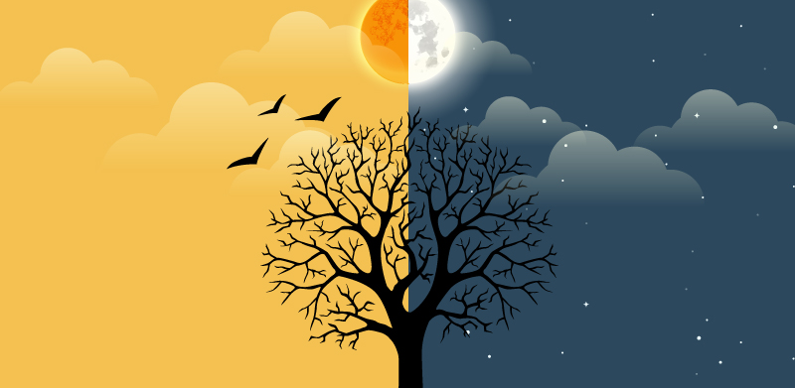
Light Control
Keep
your
days
bright
your
nights
dark
&

Slide 48
Movement
Notes:
Rule of thumb:
Stop a minimum of 90 minutes before bedtime

Slide 49
Exercise Guidelines
Aerobic activity per week
150 min moderate
75 min vigorous
Combination
Strength Training
All major muscle groups 2x/week
1 set of 12-15 reps
Aim for 30 minutes of moderate exercise each day.
Notes:
Moderate aerobic exercise includes activities such as brisk walking, swimming and mowing the lawn. Vigorous aerobic exercise includes activities such as running and aerobic dancing. Strength training can include use of weight machines, your own body weight, resistance tubing or resistance paddles in the water, or activities such as rock climbing.

Slide 50
Communication
Post
Educate
Stick to it
Notes:
Post Schedule
Educate Family and Friends

Slide 51
Additional Resources
Notes:
Another resource is our online module on how stress and fatigue affects how your brain processes information and impacts your safety.

Slide 52
Additional Resources
Notes:
Another resource is our online module on how stress and fatigue affects how your brain processes information and impacts your safety.

Slide 53
Questions?

