Slide 1
How to REALLY Conference an MSHA Citation A Presentation for Mine Safety and Health Conference 2022, We-Ko-Pa Resort
Donna V. Pryor
Partner
Email: donna.pryor@huschblackwell.com
Phone: 303.749.7272

Slide 2
Agenda
Rule on Conferencing a Citation
Elements of an MSHA Citation
How Penalties are Assessed
Research Tools
Group Exercise
Drafting a Conference Letter

Slide 3
30 CFR 100.6
“Upon notice by MSHA, all parties will have 10 days within which to submit additional information or request a safety and health conference with the District Manager or designee.”
MSHA has discretion to grant a request for a conference.

Slide 4
Elements of an MSHA Citation

Slide 5
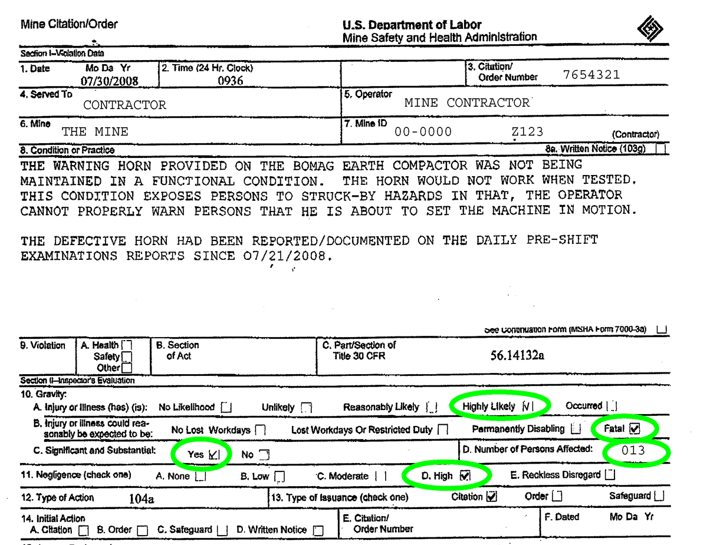

Slide 6
Mine Act is a Strict Liability Statute

Slide 7
Elements for Every MSHA Violation
Fact of violation
Was the action alleged prohibited by the standard?
Did we fail to comply with a requirement of the standard?
Gravity
How serious an accident would occur from the violation?
How likely is an accident to occur?
Negligence
What did “we” know,
When did “we” know, and
What did “we” do about it?

Slide 8
Breaking Down A Standard
30 C.F.R. § 56/57.14100(b)
“Defects on any equipment, machinery, and tools that affect safety shall be corrected in a timely manner to prevent the creation of a hazard to persons.”
Example: Miner reports the seat in the truck does not recline all the way down on their pre-shift. Is this a defect affecting safety?
Example: Miner reports fluid leaks on their truck several days in a row. Is this a defect affecting safety?

Slide 9
Gravity

Slide 10
What is the meaning of Significant and Substantial or S&S?
The underlying violation of a mandatory standard;
The existence of a discrete safety hazard contributed to by the violation;
A reasonable likelihood that the hazard contributed to will result in an injury; and
A reasonable likelihood that the injury in question will be of a reasonably serious nature.

Slide 11
Significant & Substantial
“Could” and “Might” do not mean “reasonably likely.”

Slide 12
Questions for Analyzing Gravity
How often are miners exposed to the condition?
How many miners are exposed to the condition?
How close do miners come to the condition?
What is their purpose for being there?
What is the length of their exposure?
How long has the condition existed?
What is the most likely type of accident that would occur?
What type of injury is likely to occur?
If the condition has existed for a long time, if there any history of accidents in connection with the condition?
What has been done to reduce the likelihood of injury?
Are there any MSHA statistics pertaining to the condition?

Slide 13
Levels of Negligence (30 CFR 100.3)
No negligence: The operator exercised diligence and could not have known of the violative condition or practice.
Low negligence: The operator knew or should have known of the violative condition or practice, but there are considerable mitigating circumstances.
Moderate negligence: The operator knew or should have known of the violative condition or practice, but there are mitigating circumstances.
High negligence: The operator knew or should have known of the violative condition or practice, and there are no mitigating circumstances.
Reckless disregard: The operator displayed conduct which exhibits the absence of the slightest degree of care.

Slide 14
Reducing Negligence
Mitigating Circumstances: actions that reduce your level of fault
Employee misconduct
Actions of a rank and file miner were a violation of company safety policies and rules.
Company policy exists, policy is enforced (discipline records?), employees are aware of the policy
Lack of notice
Rank and file miners knew of the condition but did not report
There was no supervisor observation of the condition.
Operational or access restrictions were in place
Prior inspection of the area without citation

Slide 15
How are the Penalties for Citations Assessed?

Slide 18
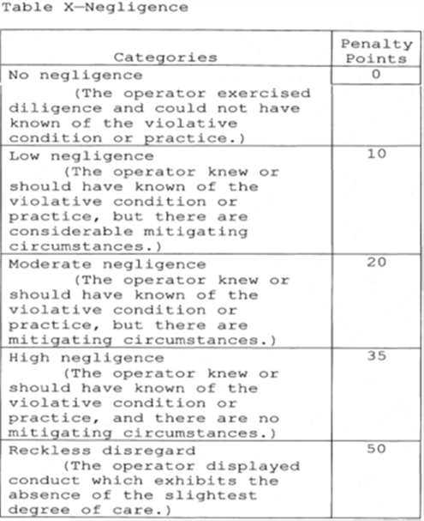
Modification Scenarios
The horn was not working, but we can show that the operator fixed it that morning after it was noted on the pre-shift report.

Slide 19
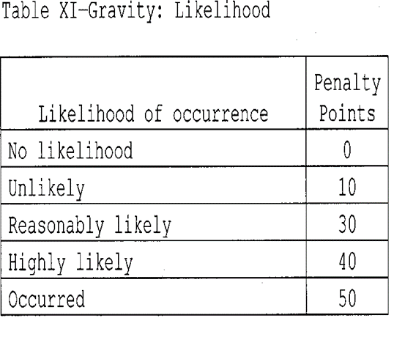
The compactor was being operated in an area surrounded on three sides by a chain link fence and on the fourth by a tailings impoundment. Signs were posted to keep individuals out of the area.

Slide 20
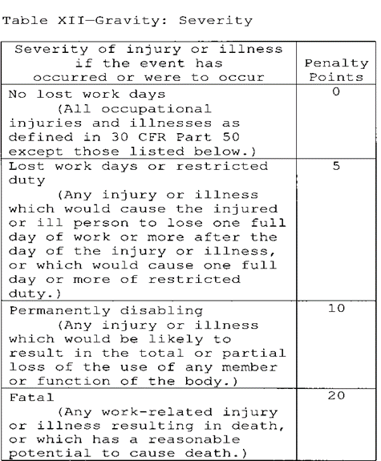
And, we don’t think this would result in a fatal accident, so what if we get the severity reduced from fatal to lost workdays or restricted duty?

Slide 21
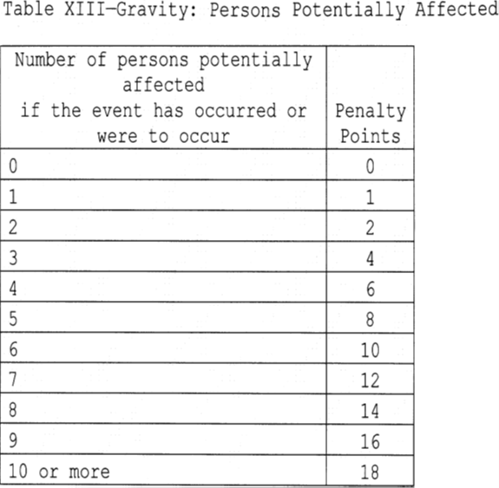
Additionally, there were only three people arguably affected by the alleged violation.

Slide 22
Here’s what would happen if MSHA accepted all of your proposed modifications . . .

Slide 23
Research Tools

Slide 24
http://fmshrc.gov

Slide 25
MSHA’s Web Site – msha.gov
Regulations
MSHA Handbooks
Coal Mine Inspection Procedures
Electrical Inspection Procedures
Metal and Nonmetal Health Inspection Procedures
Citation and Order Writing Handbook for Coal Mines and Metal/Nonmetal Mines
Program Policy Manual
Program Information Bulletins
Procedure Instruction Letters
Training Materials

Slide 26
Group Exercise
Is this a reportable injury?

Slide 27
Imaginary Citation – What Do You Do?
§ 56/57.15006 Protective equipment and clothing for hazards and irritants.
Special protective equipment and special protective clothing shall be provided, maintained in a sanitary and reliable condition and used whenever hazards of process or environment, chemical hazards, radiological hazards, or mechanical irritants are encountered in a manner capable of causing injury or impairment.
Likelihood → Reasonably Likely (Occurred)
Severity → Fatal
S&S
Negligence → High
Hint: Look at the Program Policy Manual

Slide 28
Draft Conference Letter
Dear District Manager,
[State who you are and what you want]
ABC Mining requests a conference of Citation 123456. Citation 123456 alleges an S&S and high negligence violation of 30 CFR 56.15006. The citation alleges that ABC Company failed to provide special protective equipment that was in a sanitary and reliable condition because a bat was found in a miner’s boot.
[Applicable standard]
The standard provides: Special protective equipment and special protective clothing shall be provided, maintained in a sanitary and reliable condition and used whenever hazards of process or environment, chemical hazards, radiological hazards, or mechanical irritants are encountered in a manner capable of causing injury or impairment.
[Research or Argument]
The MSHA Program Policy manual states: The standard is intended to cover obvious work situations where the normal and ordinary work clothing and safety equipment provided by the miner for his/her own protection is not adequate to provide the level of protection required for the work being done. Usual items, such as safety glasses, hard hats, and safety-toed shoes, would not normally come under this standard.
[What you want]
Based on the language of the Program Policy Manual, this standard does not apply. ABC Company requests that this citation be vacated.
[Say something nice.]
Thank you for your attention to this matter. I look forward to working with you to resolve this matter.

Slide 29
Takeaways: Tools for your Toolbox

Slide 30
Thank You!
Donna V. Pryor
Partner
Email: donna.pryor@huschblackwell.com
Phone: 303.749.7272

