Slide 1
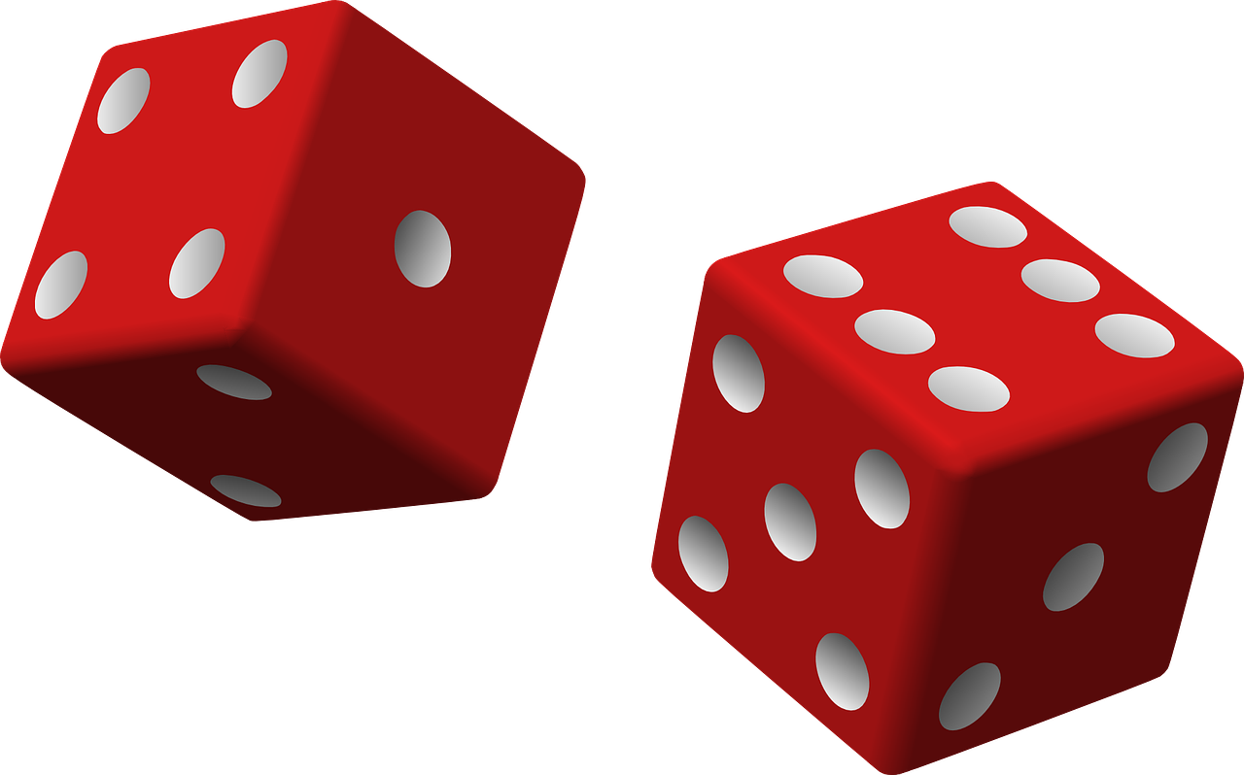
Incorporating Games in Part 48 Training
Presented by David R. Lauriski, M.A., EMCIS Program, Colorado School of Mines
This presentation is supported by the Grant or Cooperative Agreement Number, U60OH010017, funded by the Centers for Disease Control and Prevention. Its contents are solely the responsibility of the authors and do not necessarily represent the official views of the Centers for Disease Control and Prevention or the Department of Health and Human Services.
Notes:
Hello. I’m glad to have you all with me for today’s webinar, called Incorporating Games in Part 48 Training. My name is David Lauriski and I provide research and technical support for the Energy, Mining, and Construction Industry Safety program, or EMCIS for short, at the Colorado School of Mines. CLICK The use of games or game mechanics in educational situations has become a much more common way of engaging learners in all sorts of educational venues, and in this webinar I am going to give you a bit of a crash course so to speak on this concept, and how it used in safety training, and also a little about how gamification can be used day-to-day to give some life to safety incentive programs to improve safety performance. We’ll also take a close look at how we use games in our Part 48 training here at the Colorado School of Mines.
NEXT SLIDE

Slide 2
EMCIS: Part 48 Training at Mines
Since 1998
NIOSH cooperative agreement
Collaboration between Colorado School of Mines and University of Arizona
Notes:
As a part of the Mining Engineering Department at the School of Mines, much of what we do at the EMCIS program is provide MSHA part 48 training, including New Miner training, Annual Refreshers, and MSHA instructor courses for people seeking MSHA instructor certification. We are funded in large part by a cooperative agreement with the National Institute for Occupational Safety and Health, or NIOSH, and through this grant we collaborate with the University of Arizona in the innovation of new mine safety educational tools, of which gamified learning is a significant aspect.
Our program here at the Colorado School of Mines has been providing MSHA Part 48 safety training for over 20 years now, and much of our clientele consists of folks in occupations who commonly work on mine sites but would not receive their Part 48 safety training at the mines where they work. These include contractors—such as electricians, mobile equipment mechanics, or blasting engineers, for example—plus folks like vendors, consultants, industrial hygienists, and so on. We’re proud to say that a large part of our clientele are repeat customers, and so I hope to show you a little today why that is.
NEXT SLIDE

Slide 3
Games?! In my regulatory training?
Training isn’t supposed to be fun and games!
Training is supposed to be boring and tedious!
Notes:
So an integral part of our training involves using games and game mechanics. Now, that isn’t to say that our training sessions are top-to-bottom games all day. We use a blend of training methods, but games are as consistent a method we use as any other. Any particular method can overstay its welcome and become tedious, whether lecturing, showing videos, or playing games. But many folks may be skeptical of using games as a training method at all, especially when they have had no experience with it.
CLICK: Training isn’t supposed to be fun and games! Some folks may even find the use of games and introducing fun into a regulatory safety training experience to be contradictory. “Training isn’t supposed to be fun,” they might say. Or, “Learning to work safely needs to be taken seriously, and playing games is not serious.” CLICK: Training is supposed to be boring and tedious! In fact, people with this mindset may often expect required training to be boring and tedious, because that’s just what they’re used to. These training methods are often characterized by a passive learning environment with monologue-style lecturing, with limited-to-no discussion or feedback, death by PowerPoint, video after video after video, little-to-no opportunities for interaction or hands-on learning.
NEXT SLIDE

Slide 4
. . . Or is it?
Training is supposed to be boring and tedious!
Notes:
CLICK: …Or is it?
Research has shown that these methods do not do trainees any favors. There are ways that the value in required training can be maximized and the outlook on required trainings can be different. Organizations that have altered their approach to required training in beneficial ways have seen marked improvements in safety performance. Training that incorporates interactivity, discussion, continuous feedback, and combines visual, auditory, and kinesthetic methods has been shown to improve learning outcomes. And this is true for trainees of any generation or background, a fact we’ll touch on again later.
And, as it happens, games check all these boxes: they are interactive, occasion discussion, provide feedback, and have visual, auditory, and kinesthetic factors that increase engagement and improve retention of the knowledge being imparted. And when that knowledge may save their life, it is important that we as trainers do what we can to improve learning outcomes for our trainees, and the incorporation of games and game mechanics improves our training far beyond what it would be without.
NEXT SLIDE

Slide 5
Employees often have a negative
outlook on required training.
“Traditional” methods tend to be one-way and lecture-based, with little feedback or interaction.
Adults learn differently than young people do.
Kapp (2012), Leaman (2014), Trout (2015)
Notes:
It may seem contradictory, but even though many employees may be skeptical of introducing games into their safety training and may support “traditional” training methods because it’s what they’re used to, they still don’t actually like the training. CLICK Why? Because the methods that are favored in these kinds of trainings are not as engaging as methods that favor interactivity, participation, feedback, and a variety of learning styles. The methods are often one-way, lecture based, and with little feedback or interaction.
CLICK It is also important to consider that adults—the population comprising the workforce—learn differently than young people do, and they require an approach that emphasizes the relevance and usefulness of the information they’re being required to learn. Plus, adults do not make up only one generation of the workforce, and there are clearly evident differences in how different generations learn. We’ll get into that a little more later on. But before we do, let’s examine the things that are problematic when it comes to “traditional” methods.
NEXT SLIDE

Slide 6
Characteristics of Ineffective Training
Limited or no interaction
Limited or no opportunity for feedback
Testing of learning is comprehensive and happens only once
Limited or no use of visual or kinesthetic learning methods
Kapp (2012), Leaman (2014), Trout (2015)
Notes:
To start, we want to define “traditional” methods as those which largely involve one person lecturing, maybe with a whiteboard or a Powerpoint slideshow to accompany them. Now, this method may be suitable in the right contexts. For instance, I took a class here at Mines recently, and each class met for less than an hour. Much of it was taught in this traditional way, with some variety, and given a class of that length, it was perfectly fine. And what needed to be accomplished lasted multiple classes over a whole semester rather than in a single day. Professional training sessions, like an MSHA Annual Refresher, can last all day, and you have to cram in a lot of necessary content in that one day.
So when a training session is over-reliant on this method . . .
CLICK First, you get limited or no interaction. A good trainer will attempt to interact with the trainees by asking them questions to prompt a raised hand, or they may call on individuals to answer a question or provide their own comments. And this is indeed a good thing to do, because it is participatory, but imagine if a trainer were to overuse this technique of stopping a lecture to call for input from the audience. The lecture would slow to a crawl. The trainer has an obligation to keep the training moving forward, because there are minimums to meet for the training to achieve its own goals, and there is limited time. So, a trainer who relies on the lecture method may all but discard prompting the audience for the sake of time needed for the training to address certain topics.
CLICK
Next, you get limited or no opportunity for feedback. Research shows that receiving feedback is crucial for effective learning, and when a training session is mostly lectures and videos, any feedback would be infrequent at best.
CLICK
Next, testing of learning is comprehensive and happens only once. This is also related to feedback, but is more about ensuring that the trainees have learned the content, as through a post-training test or evaluation. But when a trainee has just sat through eight hours of a lot of content, it may be difficult to recall things that happened seven hours ago, especially when the learning was passive and unengaging. CLICK
Finally, these methods are passive and unengaging because they often incorporate very little visual or kinesthetic approaches or tools—kinesthetic meaning sensory, hands-on, interactive, that sort of thing. Sure, videos and slideshow presentations are visual, and it is better to have them than not. Yet again, they tend to be part of a passive approach to training. Visual elements can be more than slideshows and videos. They can be physical objects, such as real examples of things, like a safety harness or fire extinguisher – and allowing trainees to handle these objects helps with the kinesthetic aspect too. In our classroom, we have a large spinning wheel that depicts ten energy sources that can create safety hazards, and its just being in the room draws the eye. I’ll talk more about this later, as the activity incorporating it is kinesthetic as well. Visual elements can also be posters on the walls, equipment on shelves or otherwise displayed in the training room, and also things used in gamified learning, like playing cards, game boards and tokens, and so on. You might also be seeing a pattern here, in that a lot of these visual elements are kinesthetic too.
NEXT SLIDE

Slide 7
Faults of “traditional” methods
Boring: A bored learner is a disengaged learner.
Unnecessary: Employees tend to see no value in re-learning things they feel they already know, especially when the presentation of the material is not engaging.
Limited outcomes: Trainees tend to forget most of what they learn in a training session, because:
Insufficient feedback: Traditional methods do not often facilitate reflection or self-evaluation.
Notes:
So, when traditional methods ineffectively engage trainees, here are the perspectives you get: CLICK Boring: A bored learner is a disengaged learner. A disengaged learner is not learning. If we as trainers want to help keep that trainee safe, we need to make sure we have that trainee’s attention and that they are actively thinking about the material they’re being presented. CLICK Unnecessary: Employees tend to see no value in re-learning things they feel they already know, especially when the presentation of the material does not engage them, and the feeling of tedium is compounded when the training covers the same material using the same methods in the same way, every time. When you change the way you present material, it is automatically engaging, even if the trainee feels they already know it. But a more effective presentation may provide a new perspective, and a new perspective is more engaging than the same old stuff. CLICK Limited outcomes: Trainees tend to forget most of what they learn in a training sessions. And this is because of: CLICK Insufficient feedback: Traditional methods do not often facilitate reflection or self-evaluation. The material is presented, the trainees are expected to retain it. And that might be the extent of it. But this approach does not maximize the effectiveness of the training, and thus cannot improve safety performance at an individual or organizational level. Instead, training becomes most effective when it incorporates interactivity and participation, allowing the trainees to think for themselves, contribute to the discussion, and receive feedback on their training efforts. But why should an organization care about the “quality” of their safety training? Why should an organization put more effort into regulatory training? Why should they have more concern than just checking the box and meeting the regulation? Whether or not the trainees have fun during training, accidents happen, right? Unfortunately, some organizations have this negative outlook on their safety trainings baked right into their culture, and the training becomes perfunctory and minimal, enough to check the box that the training was done. The focus is on just doing the training, not making sure the training’s effectiveness is maximized.
However, I like to think that because mine workers are required to take this training and become certified, those who provide that training should feel a commensurate and equal requirement to maximize the training’s effectiveness, especially because it’s the workers’ health and safety we’re talking about. NEXT SLIDE

Slide 8
Qualities of effective safety training
Giving trainees:
Knowledge of hazards in the work environment
Tools to help reduce safety risk
Using:
Qualified professionals
Interactive content
Adult learning techniques
Auditory, visual, and kinesthetic methods
Notes:
So, conversely, let’s examine what can improve safety training by enhancing trainees’ engagement.
CLICK
For training to be as effective as it can be, it needs to give trainees the knowledge they need of hazards in their work environment. It also needs to give them tools, whether that be a literal object, something they can use in the field for hazard identification or reminders; or the tool could be a method, like a novel way of observing or thinking about the potential hazards in their work environment.
And so doing this should use. . . CLICK
Professionals who are qualified to provide that training, of course, but also interactive content. Not just a one-way delivery, but methods that cause the trainees to do more than listen and hope to retain. In addition, training should use techniques and methods meant to appeal to an audience of adults. A big part of this is ensuring trainees know the hows and whys of the training, more specifically than just the earning of the certification; in other words, what are we meant to learn here, and how does it pertain to me? And next, auditory, visual, and kinesthetic learning methods. Appealing to as many senses as possible, not only because blending these is more engaging than focusing on one or two, but because of the different ways that people learn. Some people do well to just sit and listen, others prefer to visualize what they’re learning, and others are particular to touching and interacting with things.
So, to put it plainly,
NEXT SLIDE

Slide 9
Education works best when it is
participatory.
Participation increases engagement with the material and improves knowledge retention.
Kapp (2012), Leaman (2014), Trout (2015)
Notes:
Education works best when it is participatory.
CLICK
Participation increases engagement with the material and improves knowledge retention. Learning effectiveness is connected to the level of engagement. Increasing engagement through interactivity and participation is directly linked to improvement of knowledge retention.
Like in the picture, you can see some trainees putting on a safety harness in a classroom setting. This is obviously a demonstrative, kinesthetic learning method that certainly makes sense for the topic—how to put on a safety harness.
But how do you incorporate visual and kinesthetic methods into covering subject matter that is not so obviously a hands-on activity like this one?
NEXT SLIDE

Slide 10
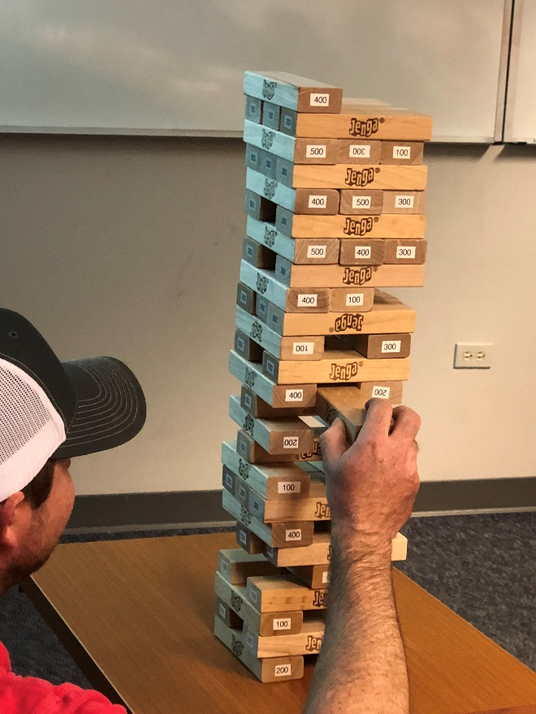
Games as a learning method
Introducing games or game mechanics into training situations has become a successful way to implement participatory elements and increase engagement.
Kapp (2012), Leaman (2014), Trout (2015)
Notes:
Well, given that education works best when it is participatory, and that blending auditory, visual, and kinesthetic methods allows you to appeal to and engage to a diverse range of adult learners, we can begin to see how games and game mechanics could be utilized in a training session to check all those boxes.
Introducing games or game mechanics has become a successful way to implement crucial participatory elements into important training sessions, as well as increase engagement. And that leads to better retention of the subject matter. The picture here shows one of our Part 48 trainees playing a version of Jenga devised to test their knowledge, and I’ll give a bit more detail on that particular game later.
NEXT SLIDE

Slide 11
Games as a learning method
Games appeal to people of all ages and backgrounds.
67% of American households play video games.
Plus, many people play board games, card games, and puzzles, among other analog, tactile games.
As a result, games are becoming widely-used as learning tools in training situations.
Kapp (2012), Leaman (2014), Trout (2015)
Notes:
While MSHA dictates a lot of the topics we have to cover in our Part 48 training, we take advantage of the ability to deliver training on those topics in ways that we determine. So, we can get creative. We can introduce new ideas and methods, and we stick to ones that work. So, using games has become a staple of what we do in our Part 48 training because of the outcomes it leads to. So, why do they work?
CLICK
First, games appeal to people of all ages and backgrounds. And what do you get in an MSHA training? People of all ages and backgrounds, because, not only do miners need this training, but anyone who might go onto a mine site in their line of work. And that’s a lot of different professions made up of people from every part of the country, and certainly, across the world. As long as you’re going to work at a mine site in the United States, you need the appropriate safety training. Let’s also not forget that the current workforce spans several generations, all who have certain general preferences in not only how they learn, but how they perceive and interact with the world. And if the training that they need to protect themselves and others from injury or worse, damage to equipment or property, or to reduce their exposure to health hazards, the training they receive should be tailored in ways that maximize their learning of these important concepts.
But all of these generations and people all have in common that they play games. Sure, while there may be plenty of individuals in any given class that do not play games much or at all, you can probably bet on the likelihood those individuals would not be opposed to an interactive and participatory activity in a required training class, even if it is a game. CLICK
67% of American households play video games. You can probably therefore assign a similar percentage of that to today’s workforce. I grew up playing video games, and people of my generation grew up alongside video games growing up, so to speak. It’s not just Mario and Pac-Man anymore, and video games are a multi-billion-dollar industry, and games now are for people of all ages. CLICK
Not only that, but non-video games are as popular as they’ve ever been, like board games, card games, and puzzles. Maybe even in spite of the rise of super realistic video games, and the way technology has become a huge part of our lives, in the form of smartphones, tablets, driverless cars, smart homes and appliances, and the way a lot of occupations require the sitting in front of computer screens most or all of the day. Analog media and forms of entertainment, like table top games, vinyl records, and cards have resurged in popularity, so trainees aren’t going to be put off by playing a bit of Jenga instead of looking at another slideshow presentation. CLICK
So, as a result, games are gradually becoming a common aspect of effective training situations. Playing games or adding game mechanics to non-game situations—non-recreational situations—adds fun to what could otherwise be a forgettable or even dreary experience.
NEXT SLIDE

Slide 12
definition
Gamification
Gamification is the adding or incorporating of game elements or mechanics to a non-game activity or situation.
Playing a game built around the material to be learned or reinforced.
Adding game concepts to a non-game situation to enhance participation.
Notes:
Let’s take a closer look at the word of the day.
CLICK Gamification is the adding or incorporating of game elements or mechanics to a non-game activity or situation. When that “non-game activity or situation” is an educational one, we call that gamified learning.
While this webinar will focus on gamified learning, and how we at the Colorado School of Mines use games in our MSHA Part 48 classes, gamification in general can occur outside a training situation. We’ll examine a little later some examples of how companies have successfully introduced game mechanics into their day-to-day operations to improve safety performance.
CLICK
So, gamification can thought of in two basic ways. First, it can be playing a game built around the material to be learned or reinforced. This would be gamified learning, and what we typically do in our training sessions.
CLICK
Second, gamification can be a method for enhancing participation in something. In terms of occupational safety and mine safety, it could be something simple like an incentive program. In the examples later, we’ll see how, with a creative approach and proper execution, a simple game mechanic like that can have a number of positive effects.
Let’s look at a few other definitions composed by experts on the subject, to get a more comprehensive idea of what it entails.
NEXT SLIDE

Slide 13
definition
Gamification
“Gamification is using game-based mechanics, aesthetics, and game thinking to engage people, motivate action, promote learning, and solve problems. . . .
Gamification provides the designer or trainer with the tools to think about instruction from the perspective of engagement and activity.”
Karl Kapp, 2012
Notes:
Karl Kapp is an expert in instructional technology, a professor at Bloomberg University, who has written extensively on gamification. He writes that “Gamification is using game-based mechanics, aesthetics, and game thinking to engage people, motivate action, promote learning, and solve problems.”
CLICK
Gamification provides the designer or trainer with the tools to think about instruction from the perspective of engagement and activity.”
NEXT SLIDE

Slide 14
definition
Gamification
“At its simplest, gamification is the process of making nongame activities more fun and engaging.”
Carol Leaman, 2014
Notes:
Carol Leaman, CEO of the e-learning company Axonify, has written on gamification. She says, “At its simplest, gamification is the process of making nongame activities more fun and engaging.”

Slide 15
definition
Gamification
“Gamification [is] the use of contests or game-play elements to inspire desired behavior among employees. In other words, it’s playing a game in a place or context where we wouldn’t necessarily do so.”
Michael Levy, 2012
Notes:
And, finally, Michael Levy, an expert in using incentive programs to change behavior, recognizes the value inherent in using gamification to enhance occupational safety. He writes, “Gamification [is] the use of contests or game-play elements to inspire desired behavior among employees. In other words, it’s playing a game in a place or context where we wouldn’t necessarily do so.” And a safety training situation also fits under the category of “where we wouldn’t necessarily do so.”
NEXT SLIDE

Slide 16
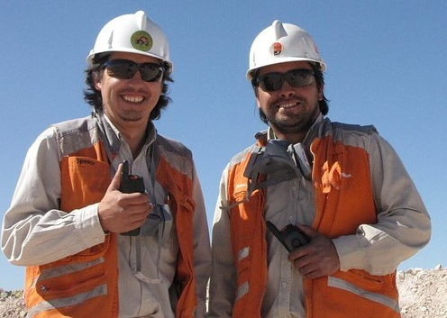
Gamification Example 1
At the beginning of the year, a sum of points are added to a “rewards bucket.”
If a lost-time incident happens during the year, a portion of the points are deducted from the bucket.
At the end of the year, the points are divided evenly among the employees, who can spend their shares of the points for rewards.
This gamified safety incentive program encouraged workers to support each other to work safely.
Levy (2012)
Notes:
So now let’s take a quick look at some examples of gamification applied in a day-to-day workplace setting as part of safety incentive program, as opposed to gamified learning in a training setting. These three examples each demonstrate a different game method applied in a workplace that successfully improved safety performance.
CLICK
At the beginning of the year, a sum of points are added to a “rewards bucket.” The rewards bucket is actually visible and able to be monitored by the employees when they access a web page they regularly use.
CLICK
If a lost-time incident happens during the year, a portion of the points are deducted from the bucket. CLICK
At the end of the year, the points are divided evenly among all the employees, who can then spend their shares of the points for rewards. Obviously, for each lost-time incident, those points are deducted for everyone, and the chance for getting the top prizes is lost. The best prizes require zero lost-time incidents in order for the employees to afford them.
CLICK
As a result of implementing this safety incentive program, the organization saw its workers support each other and speak up about unsafe behavior a lot more than they had before. A simple but effective method for an incentive program because there was a clear way to measure progress toward the goal, as well as clear, desirable rewards.
NEXT SLIDE

Slide 17
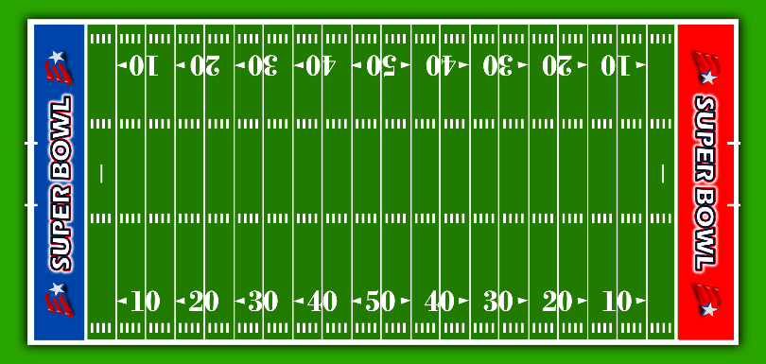
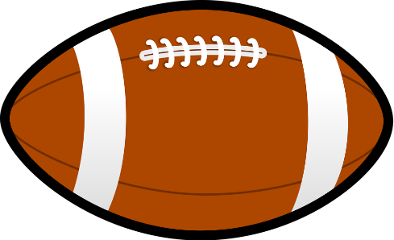
Gamification Example 2
Different work crews within the company were characterized as football teams in a league.
Each team could customize its name, its leader or “quarterback,” and a team logo, to cultivate team spirit.
Individual safety performance of each crew (football team) was measured against defined goals.
Safety performance was recorded as progress on a football field. Each crew member could access their team’s progress on the field using a web-based platform.
Teams that achieved their safety goals on the field were given rewards for their performance.
Levy (2012)
Notes:
In this example, we’ll see how using something familiar was an effective basis for a day-to-day safety performance incentive game.
CLICK
At this company, different work crews were characterized as football teams in a league.
Each team could customize its name, its leader or “quarterback”, and a team logo, to cultivate team spirit. It’s also engaging for employees to have agency and ownership over their identity in the game and enhance a sense of competition with the other crews.
CLICK
The individual safety performance of each crew—or football team—was measured against defined goals.
Then that performance was recorded as progress on a football field. Each crew member could access their team’s progress on the field using a web-based platform. The platform not only monitored the team’s progress as a whole, but individual employees—or players—as well. So, each employee had their own “stats”, just like a football player.
CLICK
And so, teams that achieved their safety goals were given rewards for their performance, and the best performing teams got the best rewards and bragging rights as safety champions.
NEXT SLIDE

Slide 18
Gamification Example 3
Employees were divided into teams, who strategized among themselves how best to avoid accidents.
Every month, each employee who had an incident-free month was rewarded with cash.
The team-based program inspired an air of competition between the teams.
The healthy competition to work safely and the monetary reward improved safety performance as well as employee morale.
Levy (2012)
Notes:
In this case, straight up cash was the incentive for this. Employees were divided into teams. They strategized among themselves how best to avoid accidents.
Then, every month, each employee who had an incident-free month was rewarded with cash. Hard to argue with that incentive, right?
CLICK
Now, the team-based program inspired an air of competition, and there was a real and tangible monetary reward for working safely. And the getting paid extra for staying safe improved employee morale, probably unsurprisingly.
So now that we’ve seen a bit how gamification can add some flavor to safety incentive initiatives, now let’s take a closer look at the gamification of a training situation, or gamified learning, especially through the lens of providing training for Part 48 as we do at the Colorado School of Mines.
NEXT SLIDE

Slide 19
The Value of Gamified Learning
Games increase learner engagement
Can provide immersive learning experiences
Provides environment where failure can be explored without consequence
Appeals to intrinsic and extrinsic motivators
Kapp (2014); Leaman (2014)
Notes:
We’ve established how at its root, playing games increases participation and appeals to all the senses with which we take in information, thus increasing engagement. But let’s examine that with a microscope.
CLICK
First, gamified learning can provide immersive learning experiences. For instance, it could be an activity in which the goal would be to practice your learning in the form of performing a task. For instance, handling an emergency situation in the workplace, or practicing CPR. One training situation where this happens commonly as well using technology is in simulators for large vehicles like haul trucks or excavators or airplanes, in the case of pilots. Simulators like this are essentially video games with a training purpose.
CLICK
Next, a gamified learning environment provides a situation where failure can be explored without consequence. Karl Kapp explains that “The risk of failure without punishment is engaging. Learners will explore and examine causes and effects if they know it’s OK to fail. In many cases, they will learn as much from seeing the consequences of their failure as they will from a correct answer.” You may recall that feedback is a crucial element of effective learning. Being able to be wrong and learn why shows the value of gamification in providing that feedback.
CLICK
And third, gamified learning appeals to “learner’s intrinsic and extrinsic motivators,” which Carol Leaman defines as such things as “tangible rewards, peer recognition, and self-efficacy,” or simply, “belief in one’s ability” (Leaman, 2014). These motivators are what fuels engagement in the game activity, and when there are no real stakes, people are inclined to have fun with it. And if you’re having fun, you’re engaged with what’s happening.
NEXT SLIDE

Slide 20
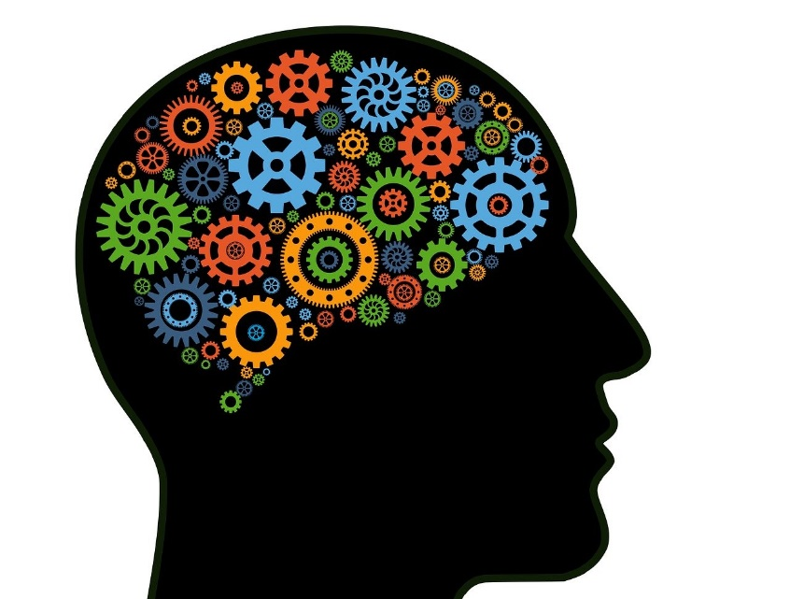
The Value of Gamified Learning
Games can cover a wide range of cognitive skills
Knowledge retention
Problem solving
Decision making
Risk taking
Leadership
Leaman (2014)
Notes:
So, what does it mean when a trainee is engaged with a game? It means something is happening cognitively. And different kinds of games can appeal to a lot of different cognitive skills.
CLICK
First, knowledge retention. Games aren’t passive learning; they’re active learning, and this leads to better retention.
CLICK
Next, problem solving. Whether alone or grouped with others, problem solving skills can be engaged in a game activity requiring them to demonstrate their learning to overcome some obstacle.
CLICK
Next, decision making. In the course of most any game, players have to make choices. And, often, making careful decisions is coupled with . . . CLICK
Risk-taking. Any engaging game has an element of risk, and the risks players take enhances the suspense and the challenge, and something with some suspense and challenge to it will in general be more engaging than something that does not. CLICK
And following those two, leadership. And a way that this skill is commonly exercised in a gamified learning situation has to do with decision making and risk taking also. For instance, in a team-based game, who among the team makes the final say on the rest’s behalf? Who will delegate tasks? Who will speak for the team? And so on.
NEXT SLIDE

Slide 21
The Value of Gamified Learning
Many people in the workforce have grown up playing games
Games are well-suited to a diverse workforce
Young and old learners alike appreciate interactivity
Familiar game elements can accommodate many types of learners, whether different generations, languages, or cultures
Leaman (2014)
Notes:
As we’ve touched on, the mining industry definitely represents a diverse workforce. And games are well-suited to a diverse workforce.
CLICK
First, many people in the workforce have grown up playing games. As I already mentioned, games of all kinds, including video games and board games, are a popular part of our culture as well as of cultures around the world. CLICK
Next, young and old learners alike appreciate interactivity. Generally, people are more easily interested in doing something than just sitting in a chair or at a desk trying to pay attention, and that’s true for people of all ages.
CLICK
And, familiar game elements can accommodate many types of learners, whether different generations, languages, or cultures. NEXT SLIDE

Slide 22
The Value of Gamified Learning
Games provide specific and frequent feedback
Player feedback is integral to game progression
Frequent or immediate feedback helps to understand the why of players’ choices while the material is still fresh
Notes:
Games provide specific and frequent feedback, and we’ve touched on how consistent feedback is necessary for effective learning and retention.
CLICK
In fact, player feedback is integral to the progression of a game. The feedback given to a player in a game makes the player decide what to do next. In other words, a game progresses through the feedback given to the players for their choices or actions, and leads to further choices. Looking at a simple example, if we’re playing Go Fish, and I ask if you have any fives, I immediately get feedback from you telling whether you have any fives, and if you do, you give them to me. If you don’t, I draw from the deck. The game progressed because of the feedback I got from the game mechanic. Transfer that to a training situation, then the feedback I get is educational and topical, and I’m learning in an interactive way through receiving regular feedback just by playing the game.
CLICK
Furthermore, frequent or immediate feedback helps to understand the why of players’ choices while the material is still fresh. Playing games can stand in for quizzing the trainees at intervals throughout a training session. It’s good to test knowledge while the learning material is still fresh in the trainees’ minds, rather than wait until the end of the day and expect them to have retained enough to demonstrate it then and there. If we play a game surrounding the subject matter we just covered, we’ll have better outcomes and better retention because of the interactivity and the focused feedback. It could be, for instance, a game-show style quiz, in which the trainees must answer questions for points. (In our Annual Refreshers, for example, we play a version of Jeopardy.) For the answers to the quiz questions, trainees get immediate feedback on whether they’re correct or incorrect, and when useful, a short discussion can help the trainees understand why they were right or wrong, and that may occasion further elaboration on the subject.
NEXT SLIDE

Slide 23
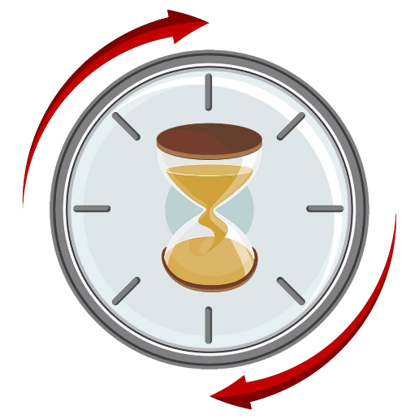
Other Benefits
Time passes quickly
Promotes communication
Encourages physical movement
Notes:
And, there are other benefits to gamified learning that can enhance the training session generally.
CLICK
First, time passes quickly. Time flies when you’re having fun, as they say. So an eight-hour training that doesn’t feel like eight hours is going to be a positive the trainees.
CLICK
Also, gamification promotes communication. Trainees and the trainers get to know each other a little bit when the trainees aren’t just sitting there in silence for the majority of the training. Communication is participatory by nature, and as we’ve learned, participation is a crucial part of effective learning. And in a team-based game, the need to communicate creates a sense of camaraderie among the teammates, as well as a sense of competition toward the other teams. CLICK
And, games encourage physical movement. For example, a lot of games you might play in a training situation require someone to stand up and move to a different part of the room, so as to write on a whiteboard, move a game token, roll dice, flip a card, or handle and demonstrate the use of equipment like a fire extinguisher. And it’s fairly common knowledge now that getting up and moving around helps get the blood flowing and avoid the fatigue of sitting in one place for extended periods.
NEXT SLIDE

Slide 24
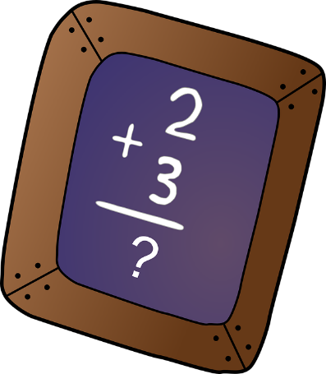
Challenges of Gamified Learning
Some trainees may struggle with game concepts or mechanics
Poor reaction to game outcomes (i.e., “sore losers”)
Variation of difficulty
Notes:
Now, even though gamified learning has a lot of advantages in creating an effective training environment, challenges may still present themselves. Things may not always go as smoothly as we would like, even though gamified learning is supposed to be fun. As trainers it is always a good idea to reflect on and evaluate the success of gamified learning situations and how they were received by trainees.
CLICK
So, some trainees may struggle with the concept or mechanics of the game being played. And this could even happen in relatively simple games. When a trainee is confused by the rules or objective of a game, it can slow the game down, limit their ability to participate, or limit their confidence as a team mate. There are ways to mitigate this, first in the design of the game; and second, as the trainer hosting the game in the moment. More on that in a minute.
CLICK
Next, sometimes people may have a poor reaction to a game’s outcome. In other words, sore losers. Fortunately, we haven’t encountered too much of this in our trainings, and big factor in that is where we place the focus during game activities. The key is to make sure the fun is a byproduct of the objective; not the objective, and this can mitigate people feeling this way. CLICK
And, variation of difficulty. Some game elements, like the questions posed to the trainees, or the tasks they’re meant to perform, might present different levels of challenge to different trainees. It’s important to remember that the trainees present in a given training could have a different level of familiarity with certain concepts, given their background or particular profession in the industry. So, it can be a challenge to achieve the right balance of difficulty for a diversely skilled group.
Although one or more challenges may become apparent, they shouldn’t be so disruptive as to invalidate the positives that gamified learning provides. In order for gamification to work best, trainers should strive to balance aspects of the game to mitigate these challenges.
Let’s examine how we might do that.
NEXT SLIDE

Slide 25
Avoiding and Overcoming Challenges
Challenge
Some trainees may struggle with game concepts or mechanics
Solution
Solution
Game concept and rules should be easily digestible and able to be explained briefly.
Adapt well-known games trainees would already be familiar with.
Notes:
So first, to help avoid trainees being confused by how the games are played,
CLICK
First, the game concept and rules should be easily digestible and able to be explained briefly. While this is beneficial for everyone, it especially serves those trainees who may not have a mind for games so that they can still be engaged and participate. In addition, it saves valuable time. In a training day, activities are often allotted a certain specific amount of time, and you don’t want to take too much of it explaining complicated rules.
CLICK
Another way to mitigate this problem is to adapt games into subject-relevant learning games that a diverse audience is likely to be already familiar with—well-known board games, card games, and even game shows. You’ll see in a minute how this is a common approach we take for developing the games we do in our Part 48 trainings.
If concepts or mechanics are too complex or unfamiliar, trainees will be confused, and their brainpower will be spent on trying to understand the game, rather than on the subject matter the game is meant to teach or reinforce. At worst, trainees could even disengage entirely, or the game will slow to a crawl because of a lot of need for clarification.
NEXT SLIDE

Slide 26
Avoiding and Overcoming Challenges
Challenge
Poor reaction to game outcomes (i.e., “sore losers”)
Solution
Set an appropriate mood and expectations for the game and its outcomes. Focus on the learning without real stakes.
Notes:
Some people may react poorly when a game doesn’t go their way or if they feel the game was unfair in one way or another. Avoiding or mitigating this requires trainers to first,
CLICK
Set an appropriate mood and expectations for the game and its outcomes. In a training situation, games should have no stakes of any significance, so that the subject matter and learning have precedent. A gamified learning environment should allow, and sometimes even encourage, wrongness or failure, without the trainee feeling as if something of importance was truly lost.
NEXT SLIDE

Slide 27
Avoiding and Overcoming Challenges
Challenge
Variation of difficulty
Solution
Solution
Consistency in use of language and structure of game elements. No tricks
Where possible, categorize or organize by subject or difficulty
Notes:
Related to this is the question of appropriate difficulty of game mechanics, such as the difficulty of questions. People in any particular training session do not have the same scope of knowledge. They aren’t experts in all things that may be covered in the training—which is a big reason why they’re trained and recertified every year.
CLICK
To mitigate this challenge, trainers and the game design should demonstrate consistency in the way language is used, as well as in the ease of engaging with game elements, like following instructions on a card, for example. Game rules, instructions, and questions should be composed in the same style, using the active voice. “Go back three spaces,” for example. Direct, simple. “What is the minimum required PPE on a mine site?” Clear. The style should by and large be simple and straightforward.
This also means you should avoid using things like trick questions or other evasive elements in a learning game. When a trainee is duped by a trick question, their reaction tends to focus on the fact that the question was a trick question, and not on what you were intended to learn from the question. Being deceptive doesn’t help trainees keep a learning mindset.
CLICK
Next, where possible, categorize or organize game questions or tasks according to subject and/or difficulty. This helps prevent trainees being caught off guard by something they can’t do or don’t know, and it helps also build confidence, especially in a team-based game, when trainees can play to their strengths to help their team.
Now, although one or more of these challenges may still manifest, with good planning and the right approach while in the training room, they can be managed. It’s a good idea to playtest a new learning game idea before presenting it to a classroom. This helps to identify any issues in the gameplay or quality of the content before being used in a training setting. It also helps to anticipate what questions trainees might have when learning and playing the game.
NEXT SLIDE

Slide 28
What Works
Appropriate Length – game should not last too long
Thoroughness – game shouldn’t leave out important topics
Timing – game should occur at an appropriate place in the training
Inclusivity – game should include participation of all trainees
Reward – game should have some additional motivation for doing well
Safe Space (allowed to be wrong) – game should not penalize “failure”; instead, wrongness is an acceptable part of the game
Game Host – the trainer facilitating the game should know the game well, be enthusiastic, encouraging, and keep the game moving forward consistently.
Notes:
Let’s take now a look at what works to help facilitate a good and appropriate learning game.
CLICK
First, an appropriate length. The game should not last too long. As we’ve touched on earlier, anything can become boring and tedious if there is no respite from it. When planning a learning game for an all-day training, consider how the different sections of the training throughout the day must be structured, and how a game activity would slot in logically to that plan.
CLICK
Thoroughness. The game shouldn’t leave out important topics. The training must cover certain things to meet its minimum requirements, so, because a game is going to take up some of that time, it needs to address to appropriate depth the subject matter it’s intended to address. CLICK
Next, timing. Games should happen at appropriate places in the training. As we’ve learned, because games progress through the feedback they provide players, the games can be placed in a way that provides feedback on subject matter when it is still fresh in trainees’ minds. For instance, a game immediately following a lecture or demonstration could help to reinforce the content, which helps with retention of the information.
CLICK
Inclusivity. A game should involve the participation of all the trainees. Since education is best when participatory, trainers need to make sure that all trainees participate. Games requiring trainees to take turns help with this, as well as games requiring collaboration among the trainees.
CLICK
Also, reward. Games should have some additional motivation for doing well. While we don’t want real stakes, the fun in competition is enhanced when winning has something real associated with it. In our games, winners may get a chocolate bar, a mousepad, a deck of cards, or other little trinkets or toys.
CLICK
Safe space. In other words, in educational settings, it should be okay to be incorrect. Being wrong facilitates learning, and in a game situation, being wrong is part of the mechanics. Getting something wrong is built-in to the game design, a consideration from its conception, and it progresses the game just as much as getting something right. A game is a safe space for trial and error, being mistaken, and taking risks despite the consequences. And when we’re talking about safety in particular, the work environment should not be a place for these things.
CLICK
Finally, what works for gamified learning is a good game host. In other words, the trainer should know the game well, demonstrate enthusiasm for it, be encouraging to the trainees during the game, and keep the game moving forward by being helpful and prompting players and teams to act or respond. It’s also good to regularly remind players of their scores, their options during their turn, how much time is left, and so on.
NEXT SLIDE

Slide 29
What Doesn’t Work
Morality – game should not impinge on trainees’ sense of right vs. wrong
Over-simplicity – game should not be too simple
Trick Questions – game should not try to bait trainees to wrong answers
Abstraction/Generality – game should focus on real and specific concepts and subject matter
Prioritizing the Fun – game should prioritize the learning; fun is a byproduct of the method
Notes:
Now we’ll examine things that are detrimental to effective gamified learning. What doesn’t work.
CLICK
First, issues of morality. A game should not impinge on trainees’ senses of right vs. wrong. In other words, and especially when safety training is the subject, a game scenario shouldn’t ask players to think or act outside their sense of ethics or morality. Safety training should always appeal toward doing the right thing.
CLICK
Over-simplicity. A game should not be too simple. It needs to have some structure, some pizzazz. Something interesting, something more than, “We’ll go one by one and if you get a multiple choice question right, you get one point.” Just as games should not be too complex that they cannot be introduced and begun quickly, as we mentioned earlier, games should not be too simple. A game that is much too simple may actually disengage the trainees. For that reason, if a game happens to be pretty simple, it should probably be short in duration.
CLICK
Next, we touched on this earlier, trick questions. A game should not try to bait trainees into giving wrong answers or doing the wrong thing. Generally, these sorts of things are not appropriate for gamified learning, especially in a competitive game atmosphere, and especially where such questions or mechanics are not the point of the game.
CLICK
Then, abstraction or generality. A game should focus on real and specific concepts and subject matter rather than being overly general or even abstract in its focus or objectives. This is especially important when safety is the subject, and meeting the specific requirements for that safety training.
CLICK
Finally, prioritizing the fun and not the learning. Fun is a byproduct of the method, not the purpose of it. Furthermore, fun is subjective. Not all trainees are going to experience the same level of fun when playing any learning game, so their fun should definitely not be the primary factor when evaluating a game’s success. Instead, prioritize trainees’ engagement and interaction with the game content and mechanics. The fun isn’t a measurement of the learning. But if someone says “this is fun,” then they are paying attention. We also shouldn’t confuse making training fun with making the trainees laugh. Trainers aren’t comedians, and shouldn’t try to be. Again, fun is a byproduct of gamification. The purpose and focus is still on the learning.
NEXT SLIDE

Slide 30
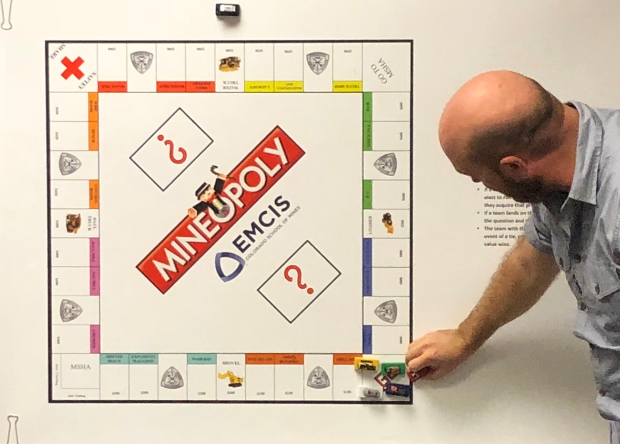
Games in Part 48 Training
Gamified learning is an integral part of the Part 48 New Miner and Annual Refresher training in the EMCIS program at the Colorado School of Mines.
Games make for a positive and memorable experience for our trainees.
Notes:
So now we’ll examine a lot of the games and gamified activities we do here at the EMCIS program at the Colorado School of Mines in our MSHA Part 48 training. As we’ve discussed, gamified learning is an integral part of our training.
CLICK For the reasons we’ve explored, games make for a positive and memorable experience for our trainees, while keeping focus on the essential subject matter they’re learning, or the important knowledge being reinforced for them.
In this picture, you can see a trainee playing Mineopoly, a favorite in our New Miner trainings. Let’s take a closer look at it.
NEXT SLIDE

Slide 31
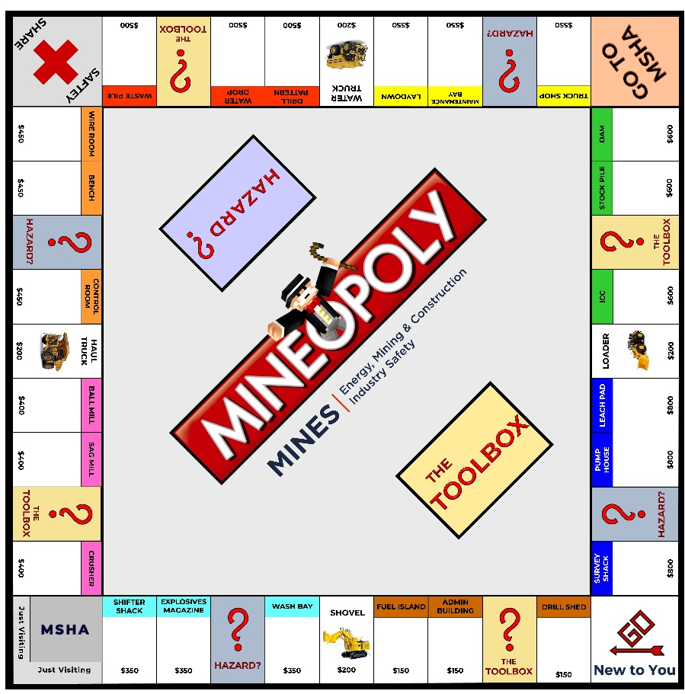
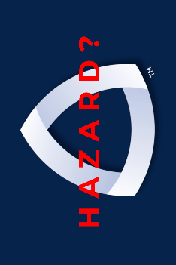
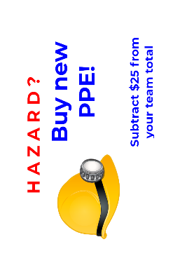
Mineopoly
Notes:
Shown here are the elements of our newest iteration of Mineopoly. Mineopoly is a good example of a game that most everyone is familiar with that had been adapted to serve a learning purpose.
When you use something people are likely already familiar with as a basis for your learning game, it’s easier for them to understand the gist of the game while also accounting for the variations in the rules you might include.
So, in Mineopoly, our trainees are divided into three or four teams, depending on the size of the class. Just as in regular Monopoly, which most everyone would know, the player teams roll dice on their turn, and advance their token around the board, trying to accumulate properties, which in Mineopoly, are locations on a mine site, like the Survey Shack or Truck Shop.
CLICK
The board is displayed on a magnetic whiteboard and held in place with magnets or binder clips, so that it is visible to everyone in the room.
CLICK
If a token lands on one of the mine property spaces, the team doesn’t buy it as in regular Monopoly; they must answer a question from the question board.
CLICK
If they get the question right, they earn the property card, and each property has a dollar amount, and that amount is added to the team’s score. Whoever has the highest score at the end of the game wins.
Questions are categorized according to their property and difficulty. So, the more expensive the property, in general the more difficult the question. Unlike in regular Monopoly, players don’t pay rent. Instead, if your team lands on a property another team already owns, you can have a chance to steal it by answering a question of the owning team’s choosing. This ups the competitive element and also introduces more questions covering the essential topics.
CLICK
Plus, just as with Community Chest and Chance cards in Monopoly, we have The Toolbox and Hazard cards, which operate similarly. They can add or subtract from your team’s total points, or cause your token to move to another space on the game board.
NEXT SLIDE

Slide 32
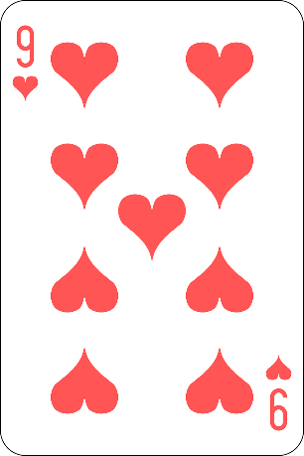
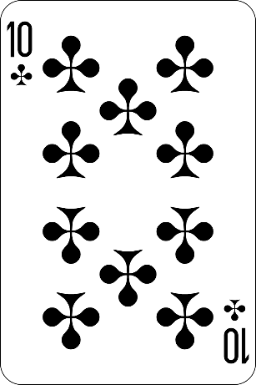
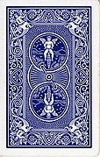
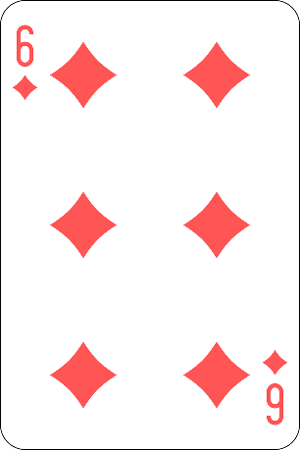
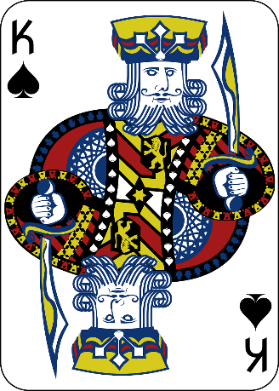
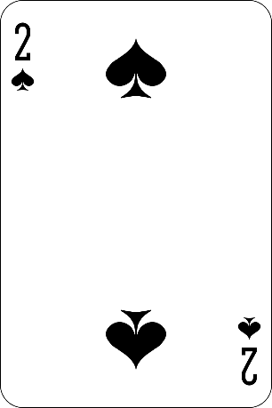
Card Sharks
Notes:
Next, we have Card Sharks. We play Card Sharks in our Annual Refresher trainings, and it is based on the old game show Card Sharks. Trainees are divided into two or three teams, and the objective of card sharks is to first answer a subject matter question correctly, and that affords your team a guess whether the next card in a sequence of five is higher or lower than the card currently being shown.
CLICK
Getting it right means your team can continue guessing cards,
CLICK
until you complete the sequence, or you guess incorrectly. CLICK
Getting it wrong means it’s the other team’s turn to answer a question, and your team’s sequence of cards starts over. A team can also freeze on any card and stop guessing to end their turn. On their next turn, with another correct answer, they start where they left off in the sequence, but get to replace the card they froze on with a new one from the deck.
To play this in the classroom, we’ve placed magnets on oversized cards so that they stick to a magnetic whiteboard they can be easily seen anywhere a trainee may be seated.
We play this typically until all the questions have been played, and the winning team is the one who has the most points by completing sequences of cards.
NEXT SLIDE

Slide 33
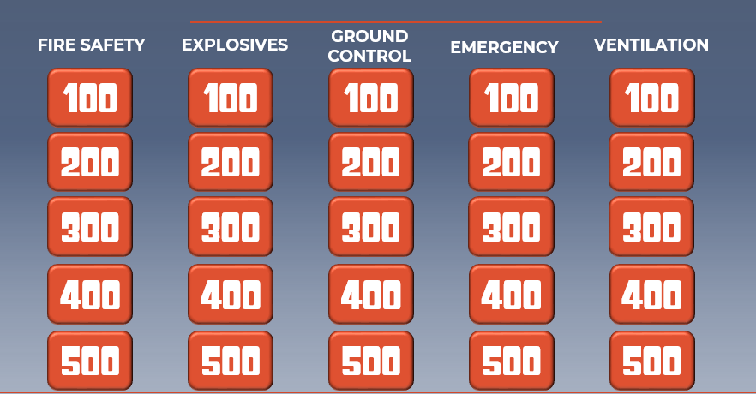
Jeopardy!
Notes:
Continuing with the theme of adapting game shows, here’s our Jeopardy game, another team-based game requiring trainees to answer questions on certain topics. We play this in our Annual Refresher trainings, and this game allows us to cover a lot of topics. We play this pretty much identically to how the game show is played. Just like the game show, we have three rounds: Single Jeopardy, and then Double Jeopardy where the point values are doubled, and then Final Jeopardy, were the trainees wager an amount of their current point total based upon the Final Jeopardy category, and then all the teams answer the same final question.
To play the game, we used handheld buzzers, and each buzzer creates a different noise to alert the trainer which team buzzed in first. The winning team is the one with the most points at the end of the Final Jeopardy round.
NEXT SLIDE

Slide 34
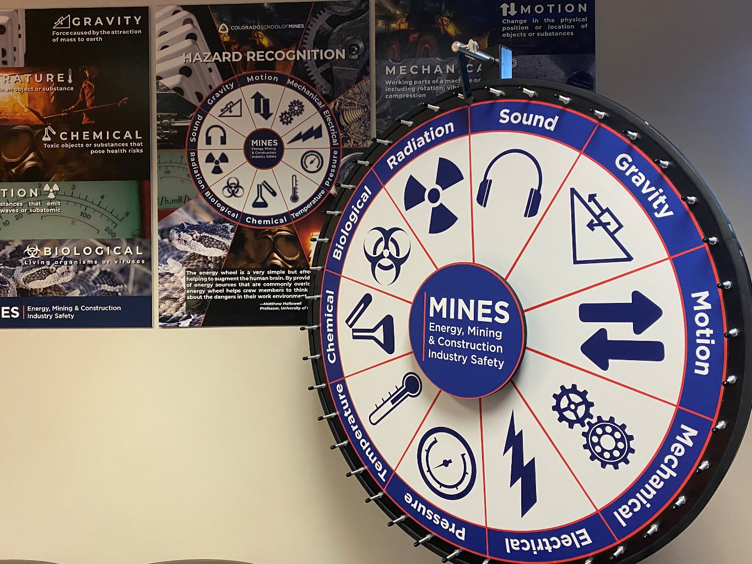
The Energy Wheel
Energy Wheel Bingo
WHEEL
OF
HAZARDS
Based on the board game Scattergories
Requires teams to brainstorm specific examples
Hazards instead of numbers
Notes:
The Energy Wheel is a new concept being introduced into the mining industry as a hazard recognition tool. You may have been introduced to it during my colleague Lori Guasta’s webinar a couple of weeks ago. It’s a way of perceiving potential hazards according to the energies that create those hazards, and there are ten of them. As I’d talked about earlier, a new perspective on common subjects is more engaging than doing it same old way, and this represents a different perspective than many in the mining industry have seen. So for our current trainings we’ve developed some game activities that implement this concept, and we use this large spinning wheel for them.
CLICK
First, a game we devised using the wheel is something I called Wheel of Hazards. This is a short and fast-paced game, lasting only 15 minutes or so, and we use it as a way to review the Energy Wheel concept after the trainees have been introduced to it.
Wheel of Hazards is based on the board game Scattergories. Trainees are divided into three or four teams. Taking turns, a member of each team comes up and gives the wheel a big spin, and whichever hazard the pointer rests on, the teams then have one minute to brainstorm a list of specific hazards that represent that energy source. For instance, if the pointer landed on sound, then the teams could start listing sources of sound hazards on a mine site: pneumatic percussion tools, continuous miners, blasting, and so on.
When the minute is over, the teams compare their lists and cross off any duplicates that other teams wrote down too. Points are awarded for every unique hazard that a team has that the other teams didn’t have.
Then, the next team gets to spin the wheel, and play continues this way until the time is up, and the winning team is the one with the most points from unique answers.
CLICK
Another game using the spinning wheel is Energy Wheel Bingo. Trainees are given bingo cards, with specific hazards in each square of the card. Rather than calling out numbers as in regular bingo, the wheel is spun, and players mark off any hazard on their bingo card that would represent the energy source the pointer landed on. For instance, if the pointer landed on Sound, a player would mark the square that says “pneumatic percussion tools,” along with any other sound hazard on their bingo card. As in regular bingo, the winner is the first to complete a row on their card.
NEXT SLIDE

Slide 35
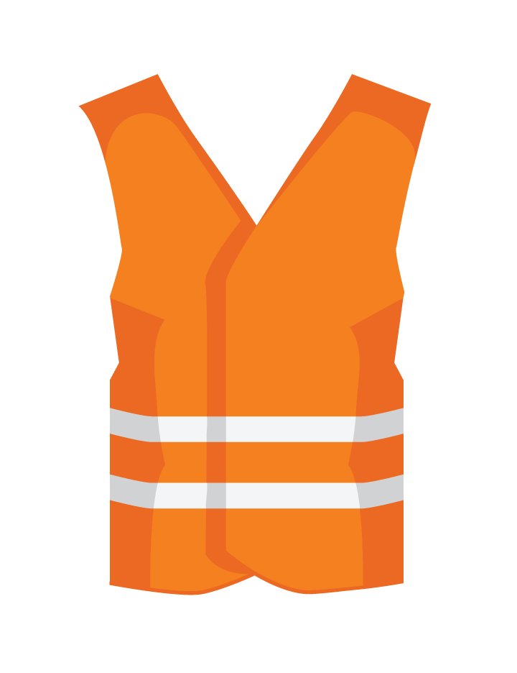
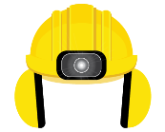
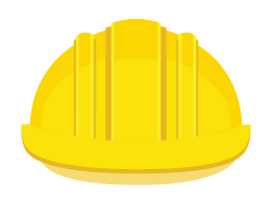
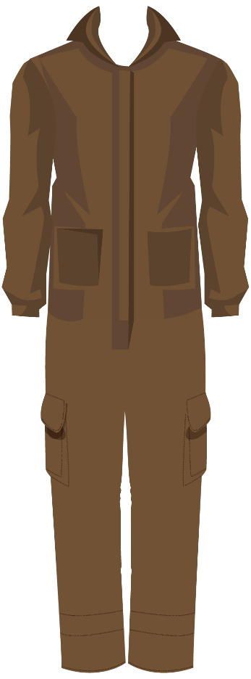
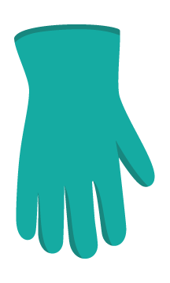
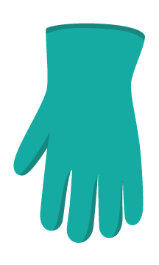
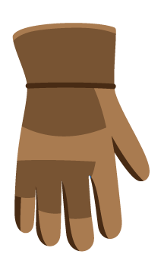
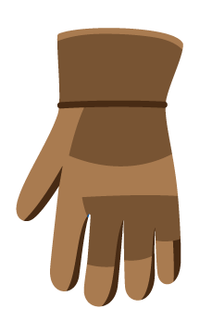
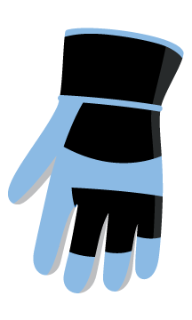
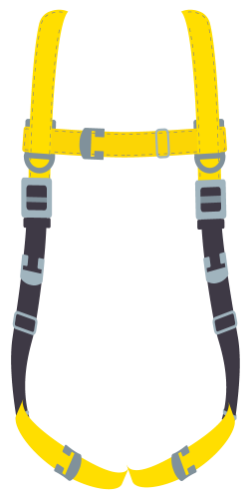
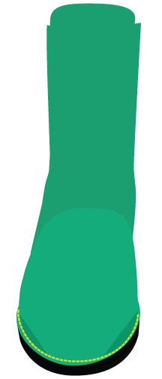
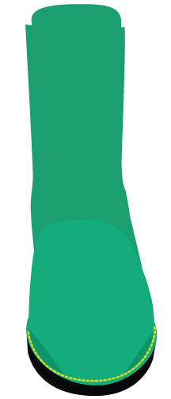
Dress the Miner
Notes:
A gamified activity we do in our New Miner trainings is called Dress the Miner. Trainees are given scenarios a mine worker might encounter, and much like playing with paper dolls,
CLICK
they must put the appropriate PPE on the miner for the given task or situation. This is just a sample of all the different clothes and PPE we have for this activity. This game is played using pretty large flexible magnets on a white board.
NEXT SLIDE

Slide 36
Jenga
Correctly answering a question allows pulling a brick from the tower
Each brick has a point value
Adds strategy and knowledge testing to traditional Jenga
Notes:
Next, we have our version of Jenga that I mentioned earlier, where we added the educational element to an otherwise very simple game and one that most everyone is familiar with.
CLICK
Trainees are divided into teams, and the teams take turns answering questions. Answering correctly allows you to attempt to pull a brick from the tower.
CLICK
Unlike normal Jenga, each brick has a point value assigned to it. Some bricks are worth 100, some 200, 300, and so on. This changes the game slightly because it’s not only about preventing the tower from falling over, it’s about accumulating points as well.
CLICK
So, players strategize a little differently, and it often lengthens individual games for the sake of getting more material covered in the question & answer portion of the game.
NEXT SLIDE

Slide 37
You Blew Up Our Haul Truck!
Notes:
And finally, I’ll share with you our version of Battleship, another example of a familiar game adapted as a question-and-answer game, called You Blew Up Our Haul Truck! Like in some of our other games, answering a question correctly allows you to progress with the game mechanic, which in this is firing a shot at the other team’s equipment, like in Battleship.
Each of the two teams is given a grid sheet where they indicate where their own equipment is placed and where they think the other team’s equipment is placed on their own sheet. A version of these grids is placed for everyone to see on a white board to keep track of where each shot has been placed. The team that eliminates all the other team’s equipment wins the game.

Slide 38
Participatory and interactive
Auditory, visual, and kinesthetic aspects
Promotes communication, provides regular and specific feedback
Appeals to a diverse workforce
Exercises a range of cognitive skills
Fun
Why Use Gamified Learning?
Notes:
So, to review a little, why use gamified learning? And why has gamified learning been a crucial aspect of the positive experiences trainees have at our Part 48 trainings?
CLICK
Again, games are participatory and interactive. The learning is not passive, it is active.
CLICK
There are auditory, visual, and kinesthetic aspects that complement each other and appeal to all types of different learning styles or preferences. CLICK
Games promote communication. A game can’t progress with people sitting in silence. And communication brings about camaraderie and enhances the competitive spirit that appeals to the desire for intrinsic and extrinsic rewards. Plus, part of that communication is the regular and specific feedback that progressing through a game provides. CLICK
Games appeal to a diverse workforce. People of all ages and backgrounds play games.
CLICK
Gamified learning exercises a range of cognitive skills—problem solving, memory, decision making, leadership, and more. Again, characteristic of an active learning situation.
CLICK
And, last but not least, games are fun. And when trainees are having fun, they’re paying attention.
NEXT SLIDE
NEXT SLIDE

Slide 39
Visit us online at
https://emcis.mines.edu
Download our game templates for your own use at
https://emcis.mines.edu/templates
Email me at
dlauriski@mines.edu
Notes:
And that will do it for this presentation on gamified learning in Part 48 training. I really thank you all for joining me today. I hope you learned a little something to take with you and share with others.
CLICK
I encourage you all to check us out online and keep us in mind when you need Part 48 New Miner or Annual Refresher training and visit us online at emcis.mines.edu.
CLICK
In addition, you can download a lot of templates and things for free for some of the games I illustrated, like Mineopoly and Jeopardy and Card Sharks, so you can adapt them for your own training purposes. They’re hosted on our Templates page on our website there at emcis.mines.edu/templates. CLICK
And, if you want to get in touch with me for any reason, feel free to send me an email at dlauriski@mines.edu.
NEXT SLIDE

Slide 40
References and Further Reading
Kapp, K. (2012). Games, gamification, and the quest for learner engagement. TD: Talent Development 66(6): 64-68.
Lauriski, D. R. & Guasta, L. (2016, November). Using brain games to raise safety awareness. Mining Engineering 68(11): 57+
Leaman, C. (2013, September 23). The future of safety training. Occupational Health & Safety. Retrieved from https://ohsonline.com
Leaman, C. (2014). Boost basic job skills training. TD: Talent Development 68(8): 34-39.
Levy, M. (2012, October 1). Get in the game: Applying gamification to on-the-job safety. Occupational Health & Safety. Retrieved from https://ohsonline.com
Trout, G. (2015). Demanding a better solution: Effective training options for the changing workplace. EHS Today 8(7): 18-20.
Notes:
Finally, I’ve got a bit of a bibliography here if you want to do some reading and research of your own. Thank you again, everyone, and at this time I would be happy to address any questions you might have.
Thank you very much.

